Slide 1
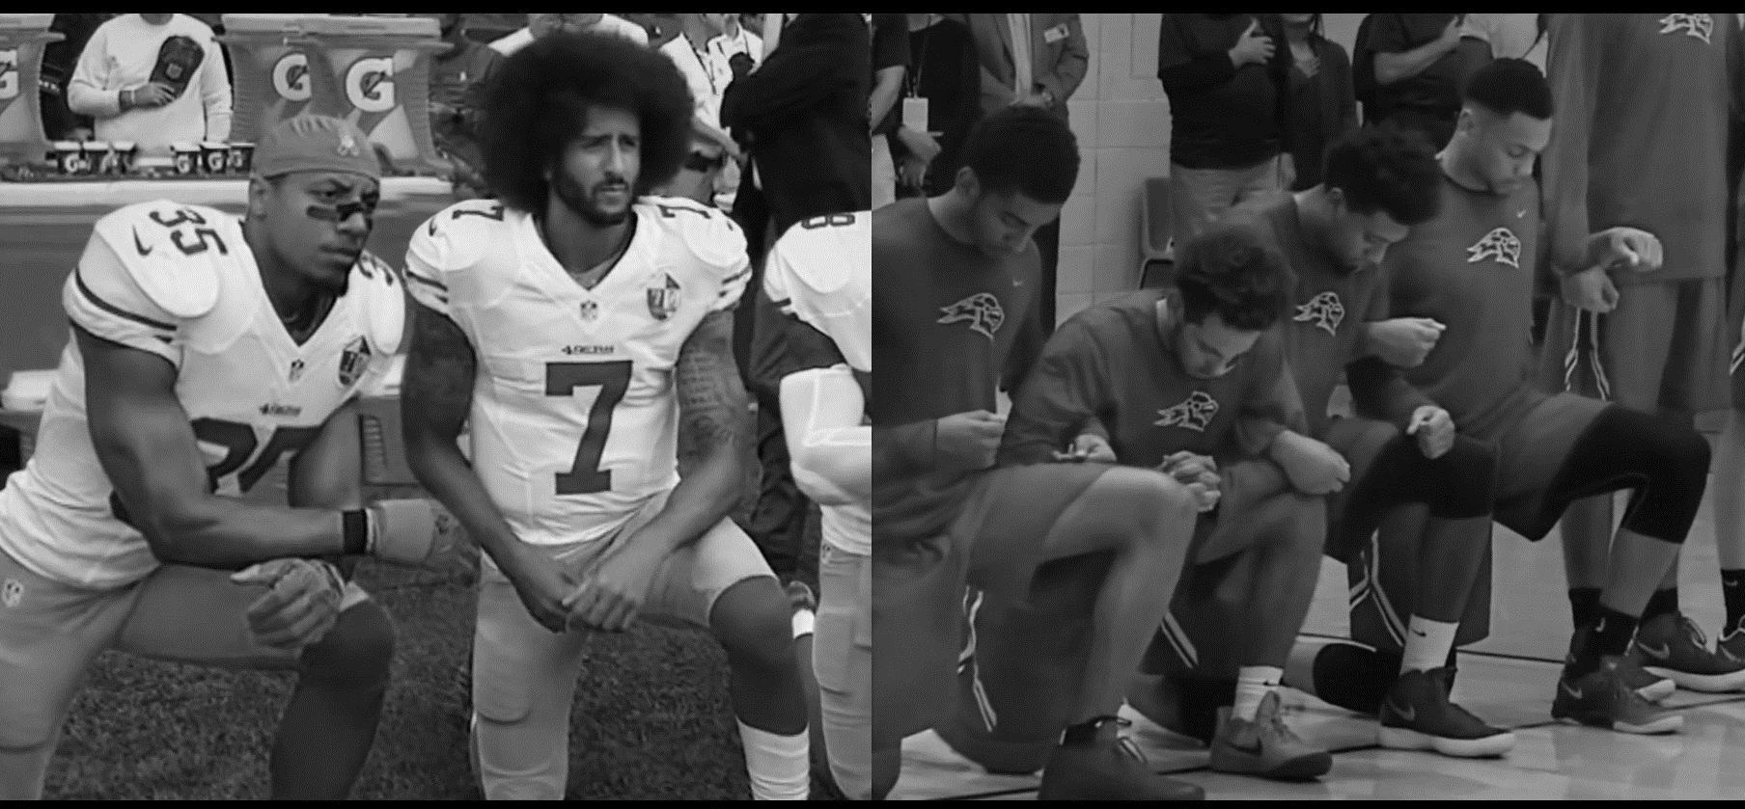

Nike: You Can’t Stop Us
Case Study USA
August 2020

Slide 2
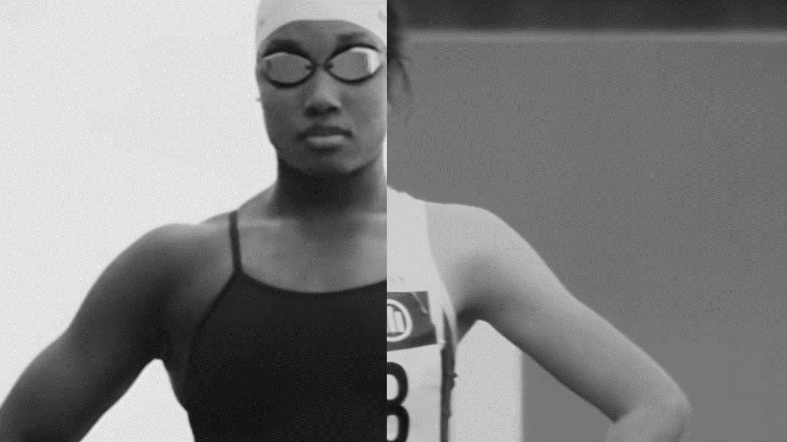
You Can’t Stop Us shows that closures haven’t stopped athletes from pushing forward and using their platforms to help create change. Nike reminds us that through a level playing field a better future is possible…

Slide 3





Nike You Can’t Stop Us Case Study
Luma surveyed a cross section of American’s about the Nike ‘You Can’t Stop Us’ ad. The survey was conducted online and was approximately 15 mins in length.
Invite & Screening | Exposure to ad | Undirected Questions | Prompted Ad & Brand Questions | Moment by Moment
Participants were invited & screened to ensure they met specifications. | The ad was shown twice. | After seeing the ad, participants were asked three undirected open-ended questions. | A series of closed-questions about the ad and brand were then asked. | Lastly they ad was replayed and we measured how they felt as they watched.
The Sample: n=158 Nat rep gender & location & aged 18+
Fieldwork: 5-6 Aug 2020
Sample Source: Lucid
3

Slide 4
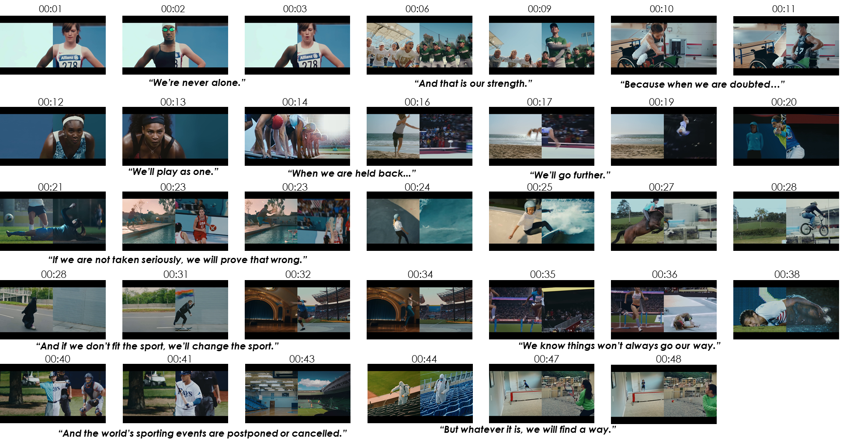
Stimulus You Can’t Stop Us

Slide 5
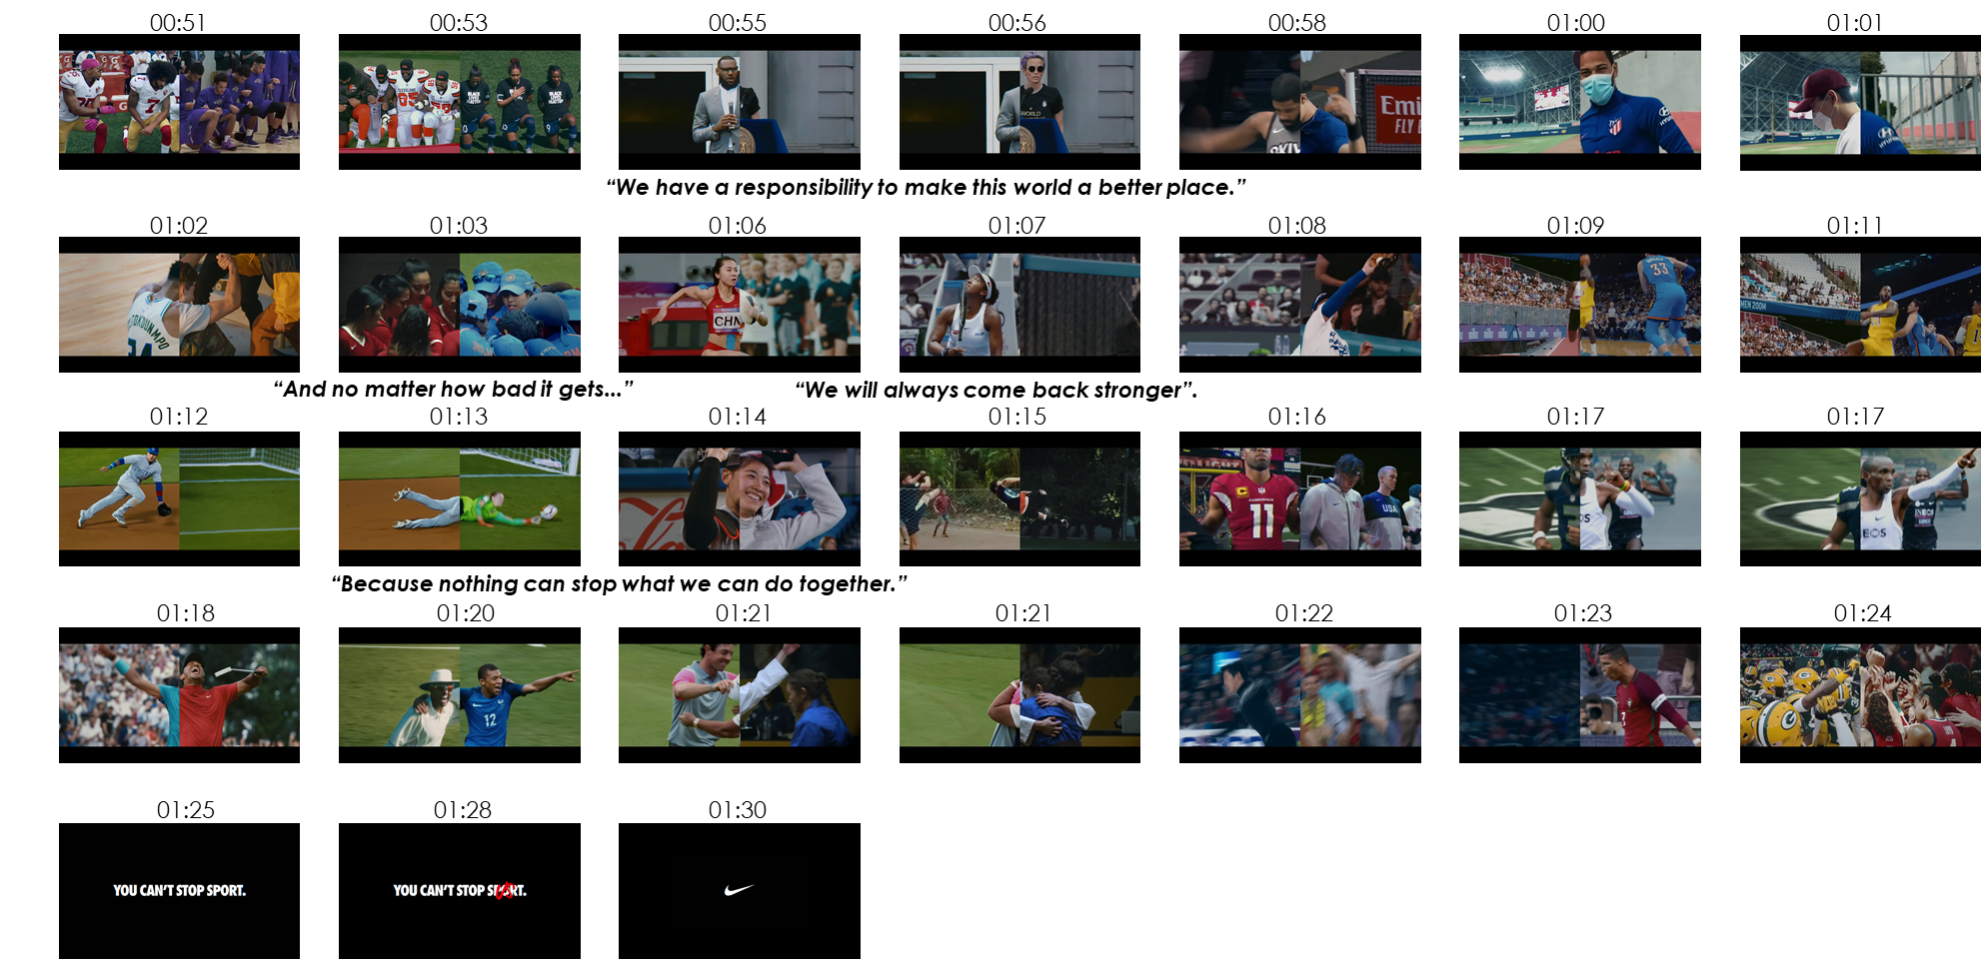
Stimulus You Can’t Stop Us
5

Slide 6
Making Great Ads To Grow Brands
We have been measuring ads for over 25 years and identified that to make a brand grow, you need ads which get noticed & make people feel good…
Salience
Get noticed &
Build link to brand
Feel Good
Leave people with positive feelings
Feelings have the strongest effect on consideration & driven by relevance of what you say & how you say it.
Drive through music, humour, casting, story telling & brand mnemonics.
6

Slide 7

Key Performance Metrics
You Can’t Stop Us is ground breaking, highly emotional and an instant hit on social media. The 90 second ad delivers the powerful story of perseverance and inspires hope in the face of adversity. It talks to race, gender and the idea that we are all in this together. Creatively the split screens pairing athletes and sports, is unique and engaging and leaves people feeling positive about Nike. There is an opportunity to improve branding which is below benchmark.
 | Effective Benchmark | You Can’t Stop Us (USA)
Ad Attention Will the ad get noticed? | 6.0 | 6.5
Message What does the ad convey? | 70% | 69%
Bonding How does it make people feel? | 6.0 | 7.2
Branding Is the link clear? | 95% | 81%
add+impact® Effectiveness Score How does it compare to other ads? | Top Quartile | Top 26% of all 8000 Global Ads
✓
✓
✓
7
✓
Meets Effectiveness benchmark.
7

Slide 8
Attention You Can’t Stop Us
The ad will cut-through and be noticed. It is seen as original and memorable and keeps people entertained. Almost half claim they will share it online which correlates with the 43 million views it received on YT in the first 7 days.
Cut Through Potential
You Can’t Stop Us is entertaining and likeable.
People love watching it and it is showing no signs of wearing out.
The elite and everyday athletes work well – they are suitable and well liked and the audience like the music.
Despite many scenes the ad is seen as easy to follow.
Effectiveness
Threshold
6.0
46%
will share online
Creative Strengths & Weaknesses
Effectiveness
Threshold
6.0
Will people watch on future exposures?
Do people like the ad?
Are people tired of seeing it?
Are the people well-suited to the ad?
Do people like the music?
Are there too many scenes/ideas in the ad?
Is the ad easy to understand?
Source: add+Impact® Attention Ratings *Note: Results shown are not means, they are standardised factor scores.
Base: Nike You Can’t Stop Us (n=158)
8

Slide 9
Positive Comments
Almost 3 in 5 people have something positive to say about the ad – it is inspiring, motivating & heart-warming and people love the visual editing.
“It was very empowering and inspirational.”
 | You Can’t Stop Us
Total Positive Comments | 55%
Inspiring/Empowering/Motivating/Meaningful/ Heart-warming | 30%
Liked/Good ad | 14%
Liked the visuals/Innovative visuals/edits | 12%
Appreciate the inclusiveness/multicultural aspects/good political points | 7%
Interesting | 4%
Liked the message | 3%
Relevant/Suitable for COVID-19 | 2%
Liked the idea/concept | 2%
60%+ Benchmark
“When looking at this advertising I felt a very loving and good feeling.”
“I really like how diverse the ad is. It helps bring people together instead of making people feel divided.”
“I Love it! The passion they bring and the motivation! A truly inspiring message.”
9
O1: What thoughts, ideas and feelings did you have when you watched this ad?
You Can’t Stop Us (n=158)

Slide 10

Negative Comments
This ad does not generate a concerning level of negative discussion, performing above benchmark. The main criticism of the ad is that it is controversial – 1 in 10 do not agree with the imagery where players kneel during the national anthem.
 | You Can’t Stop Us
Total Negative Comments | 16%
Controversial/disrespectful to the flag with kneeling | 10%
Disliked/Bad ad | 6%
Tired of brand using BLM | 2%
Dislike brand/what the brand does | 2%
Boring/same old ad | 1%
“I don’t like companies trying to use sports to push their political agenda.”
<20% Benchmark
“Screw Nike. They have provided a platform to help divide America. I will never purchase a single item from Nike. I find this ad offensive”
“It was dumb and didn’t really make a lot of sense.”
“I didn’t like it at all.”
“A bunch of athletes telling us that with sports they are going to prevail. The fact is sport is not going to stop the pandemic, science is.”
10
O1: What thoughts, ideas and feelings did you have when you watched this ad?
You Can’t Stop Us (n=158)

Slide 11
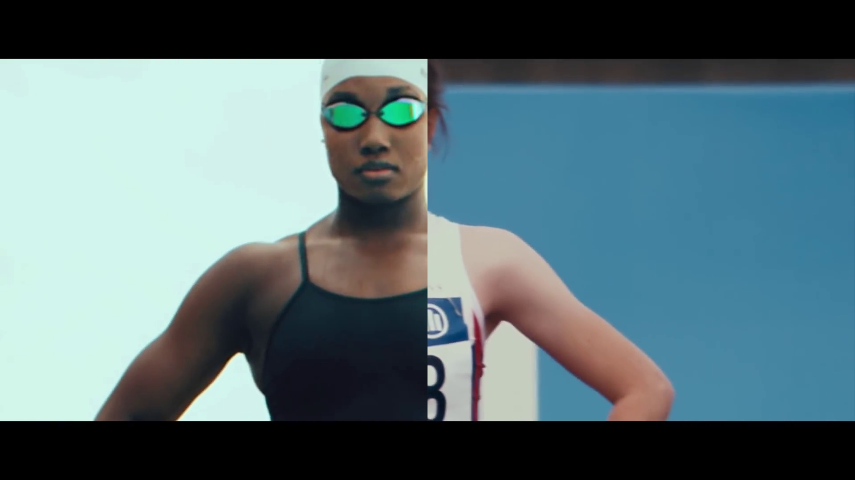
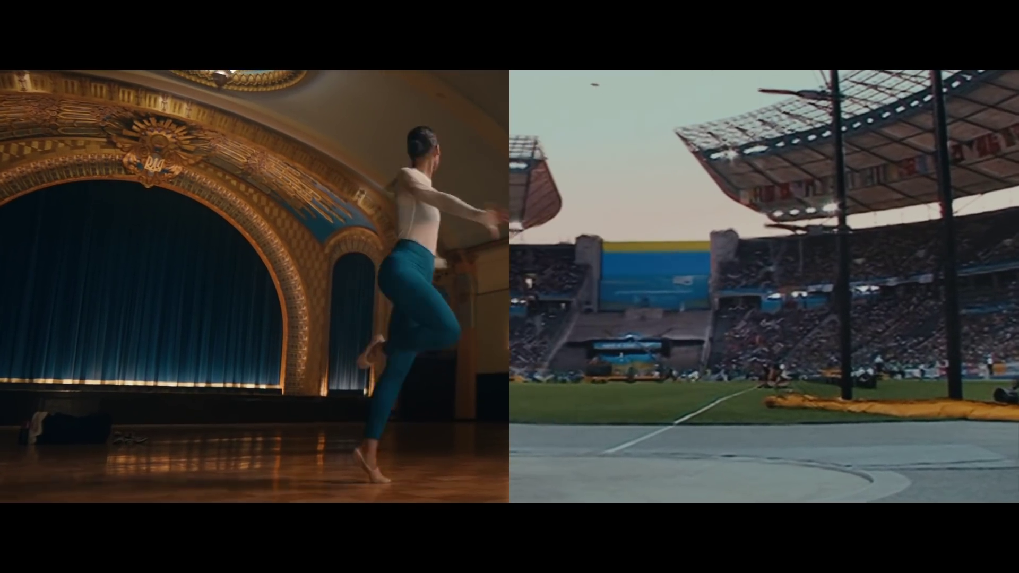
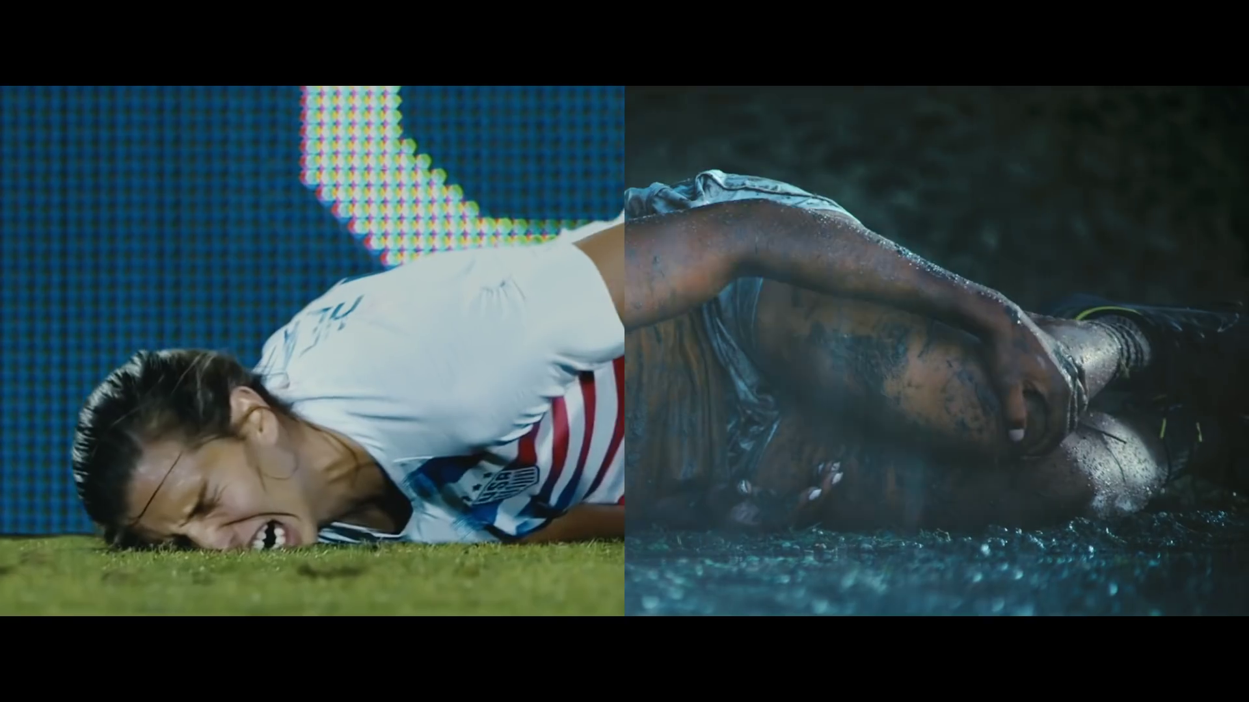
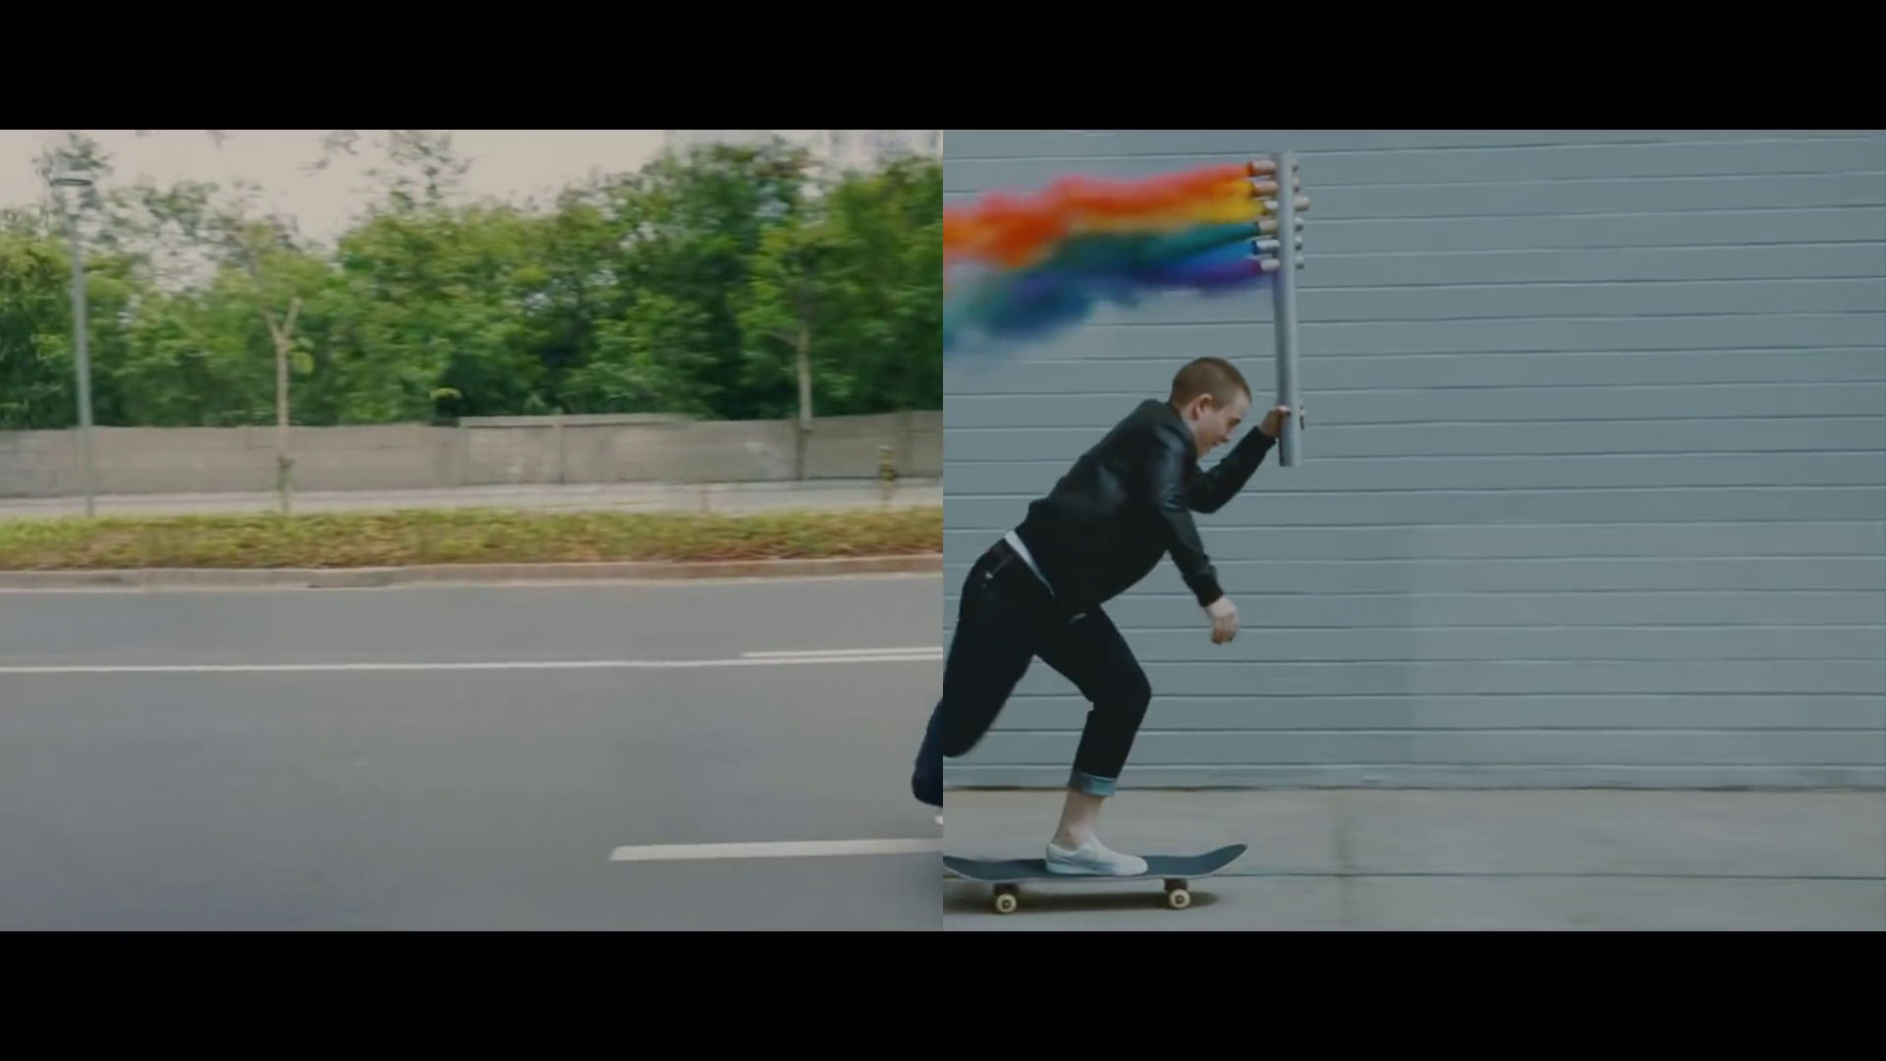
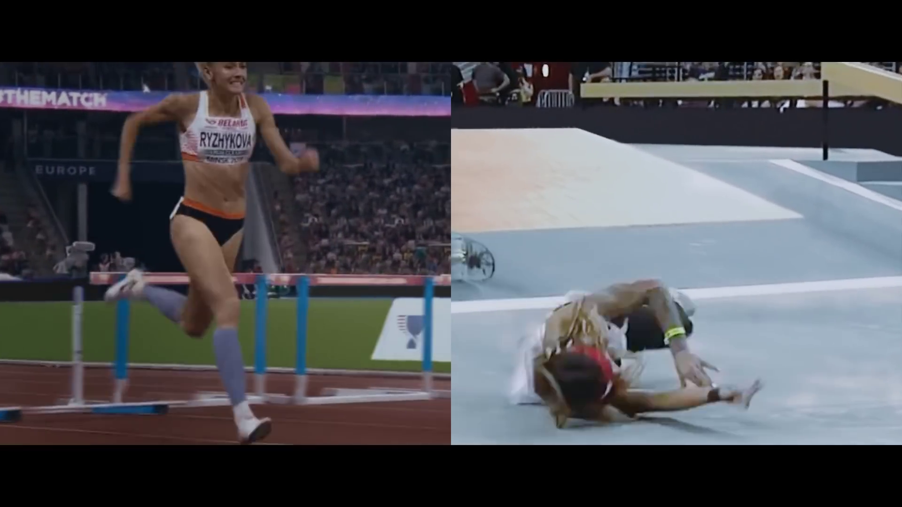
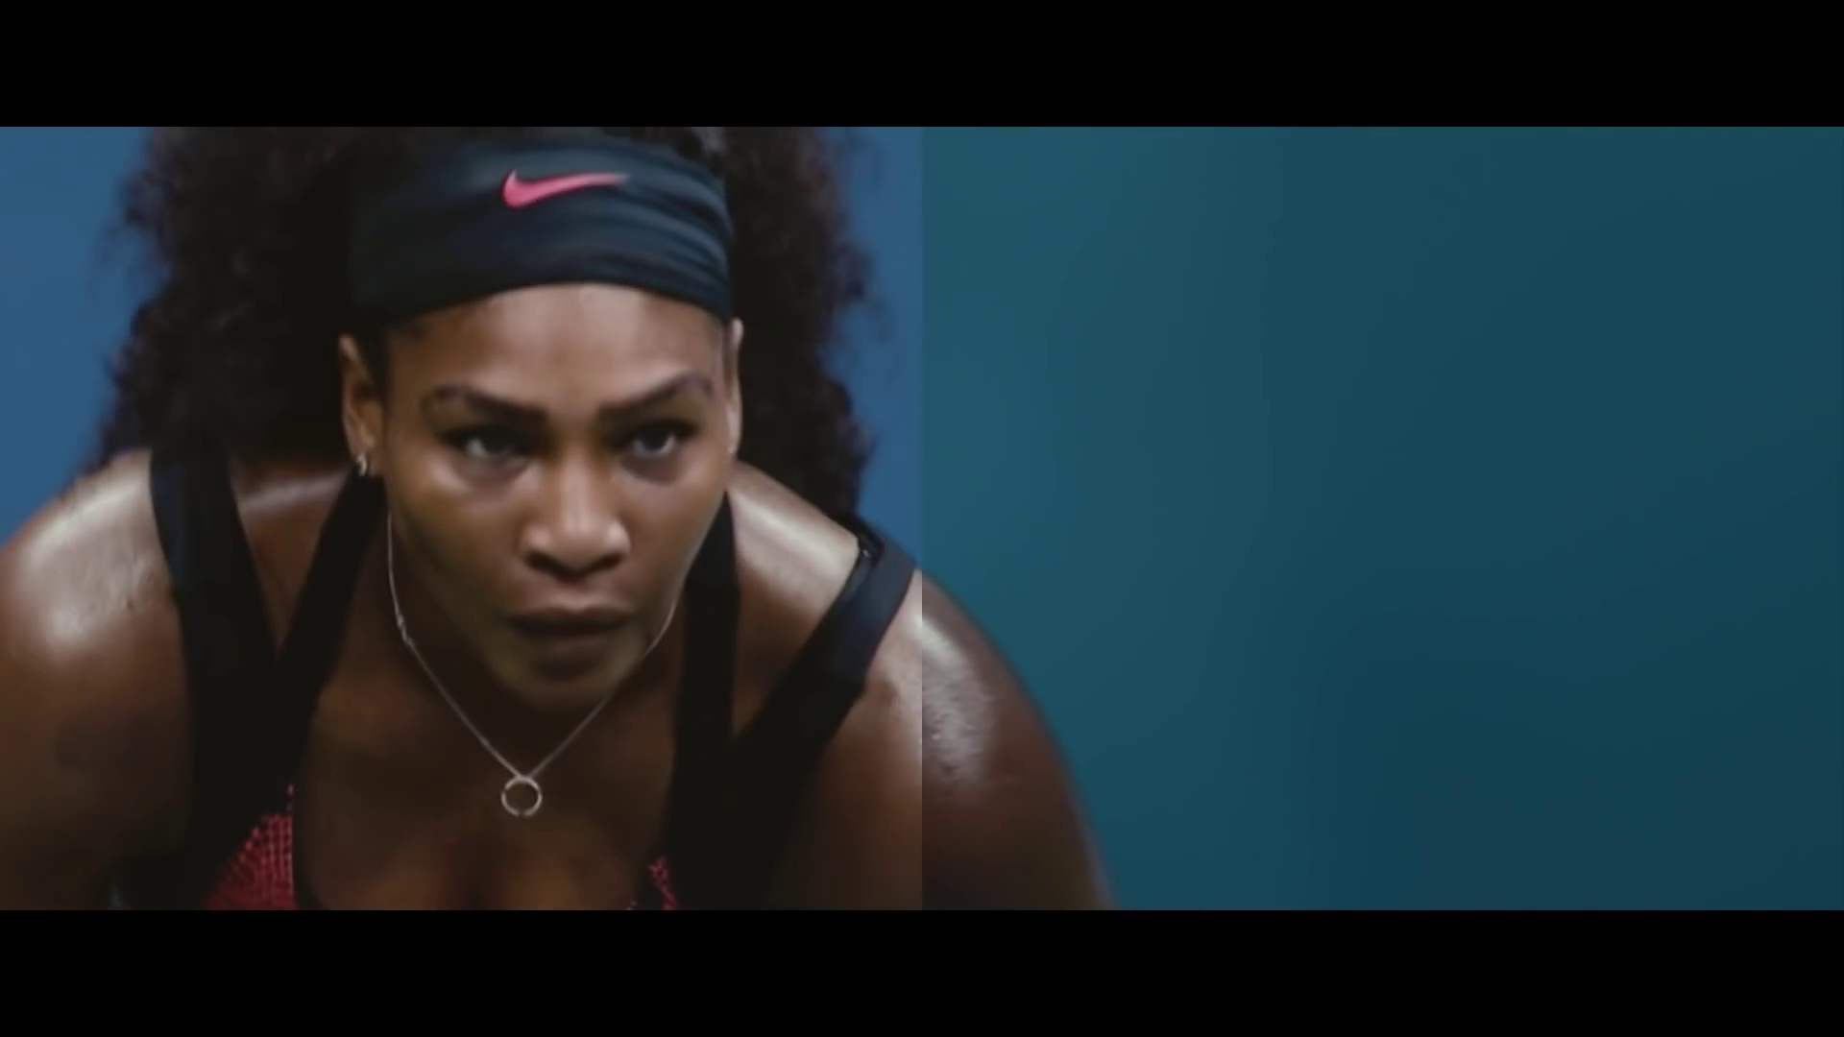
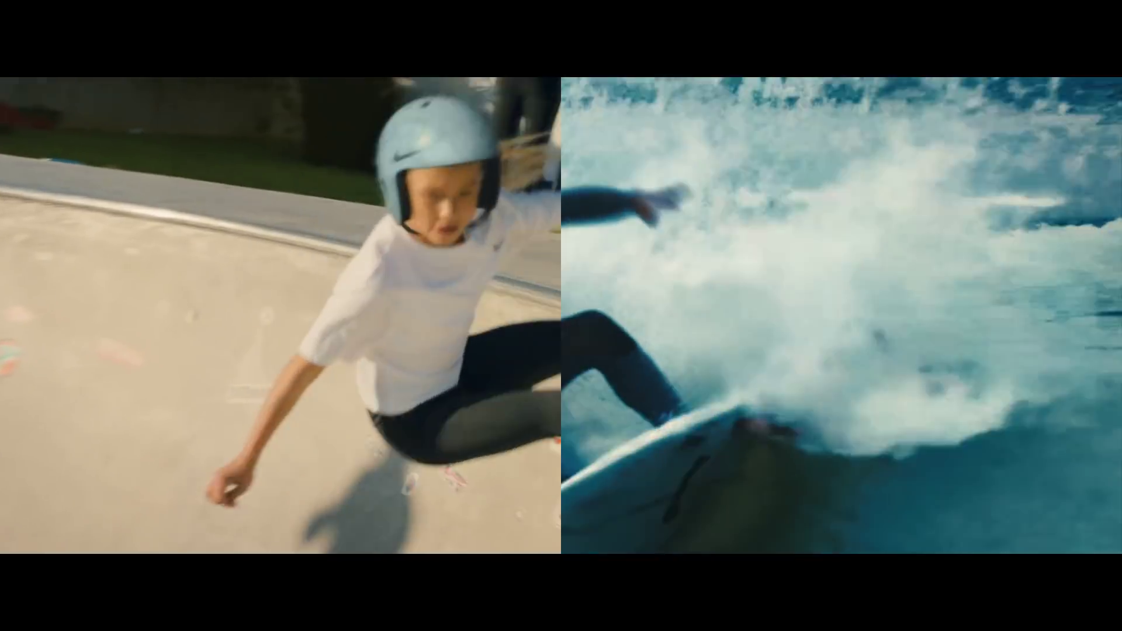
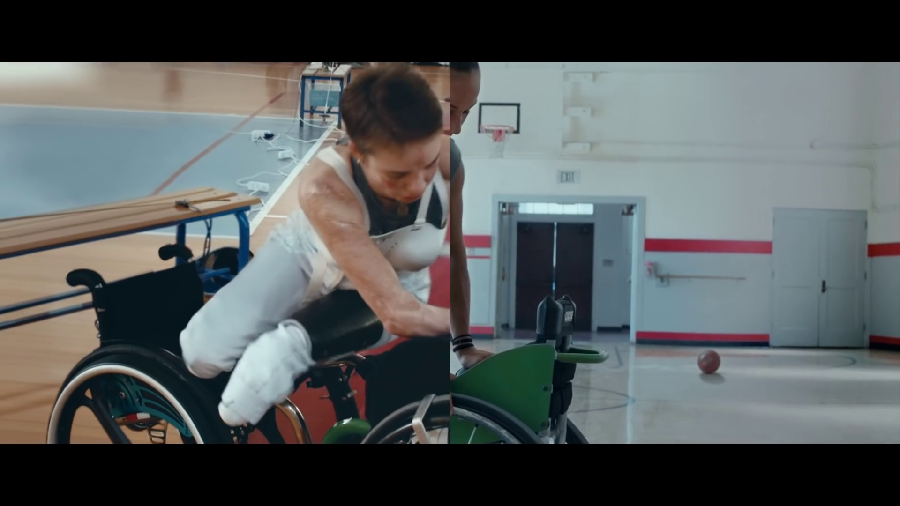
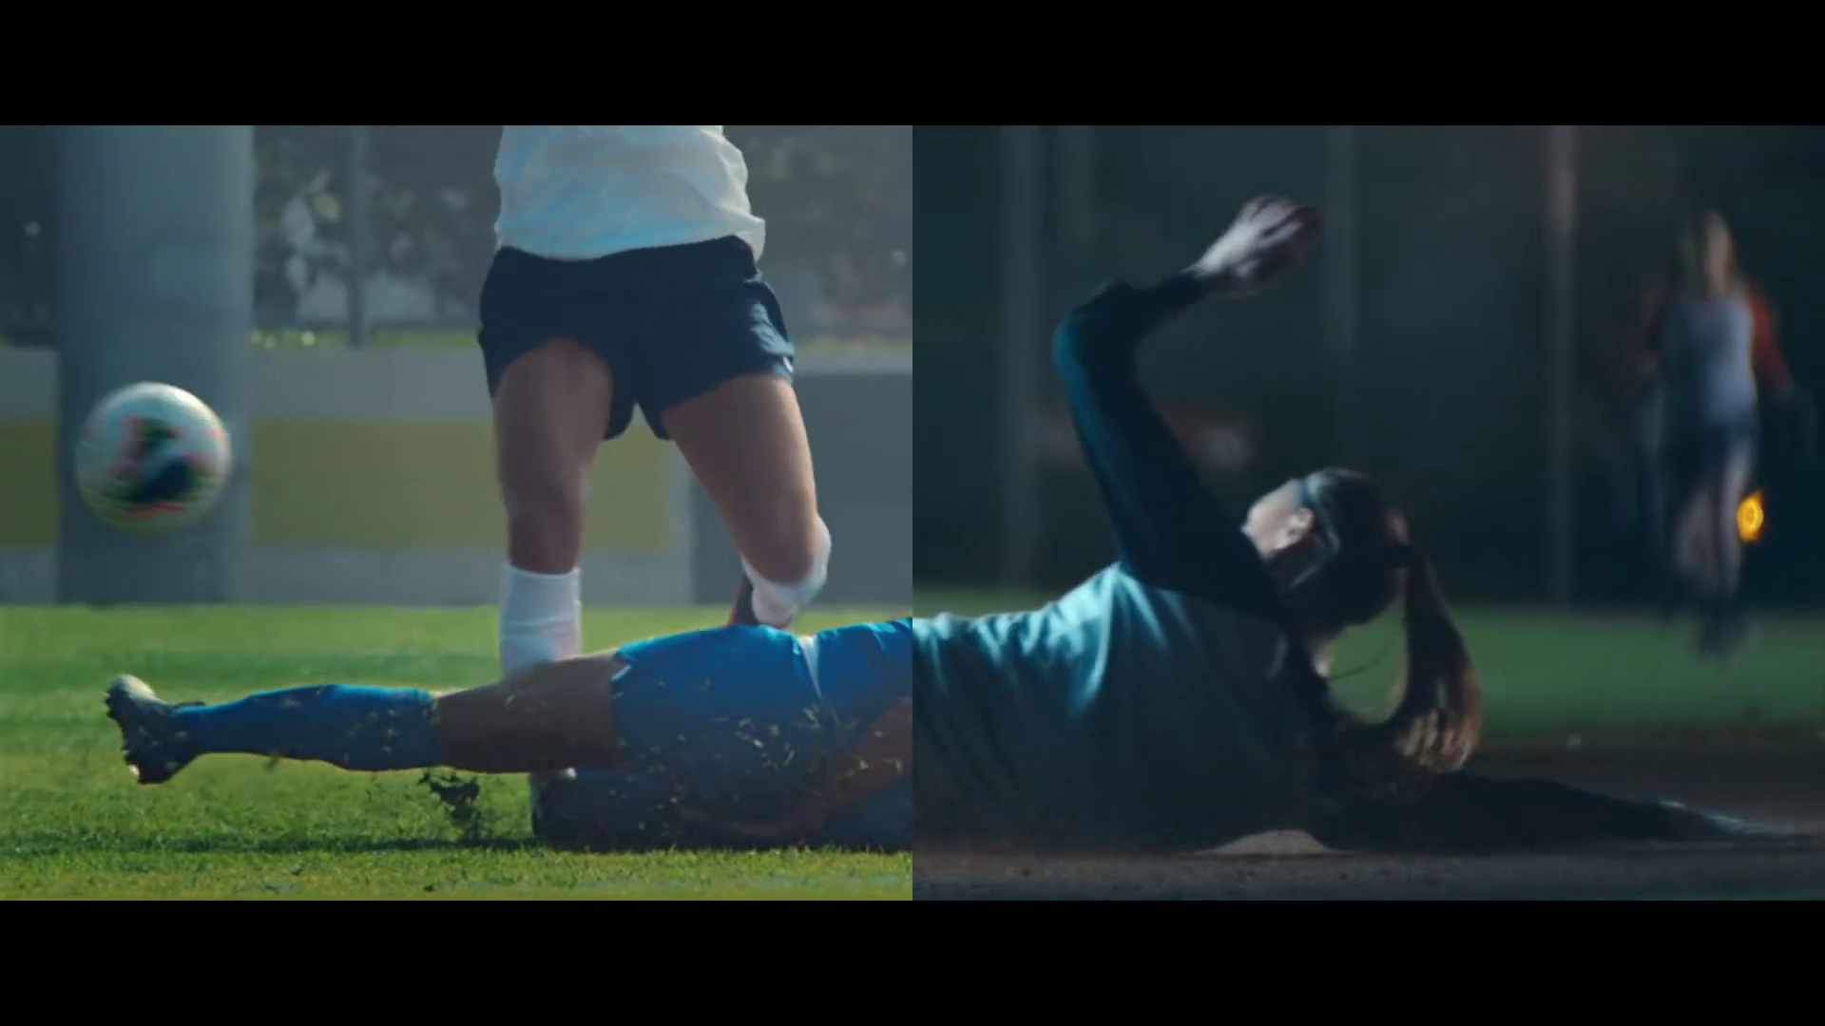
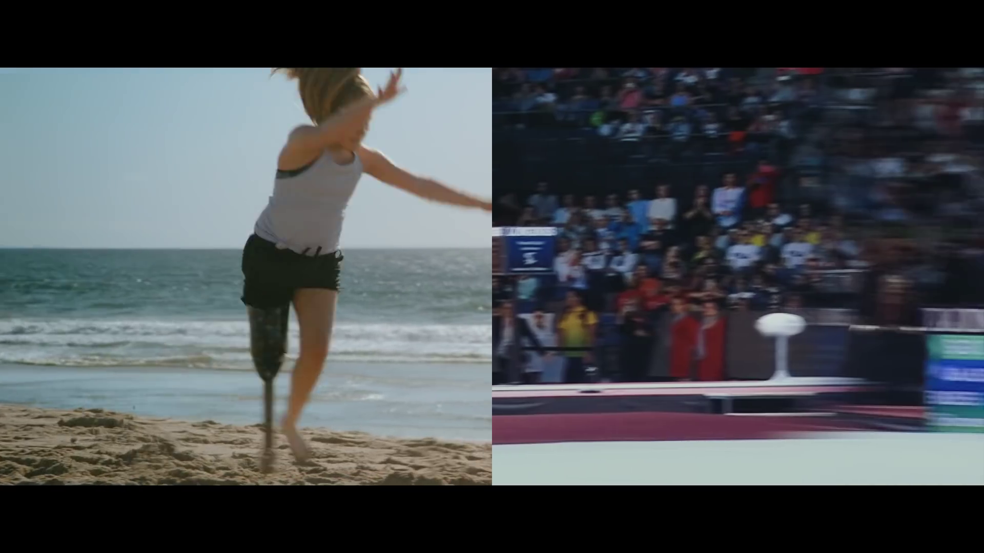
You Can’t Stop Us generates mostly positive emotions
The ad generates strong interest and inspiration throughout. Interest piques to it’s highest point at the very beginning of the ad – the first viewing of this unique editing style. Inspiration follows at key moments throughout, such as after seeing the handicapped athletes (11s), after the line “if we don’t fit the sport, we will change the sport” (31s), or during the speech for change (56s). There is a spike in annoyance at 51s, where the athletes are seen kneeling. The open ended responses (slide 10) revealed that 1 in 10 find this action to be disrespectful to the American flag. The ad ends on feelings of happiness after viewing approx. 9s of athletes succeeding and embracing each other. People feel inspired when the Nike logo flashes on screen.
Interested
Annoyed
Inspired
Inspired
Inspired
Inspired
Inspired
Inspired
Happy
NUMBER OF CLICKS
Inspired
Interested
Annoyed
Inspired
Inspired
Inspired
Interested
Inspired
Inspired
Interested
Interested
Interested
Interested
Inspired
SECONDS
11
Moment by Moment
Base: Total (n=158)

Slide 12
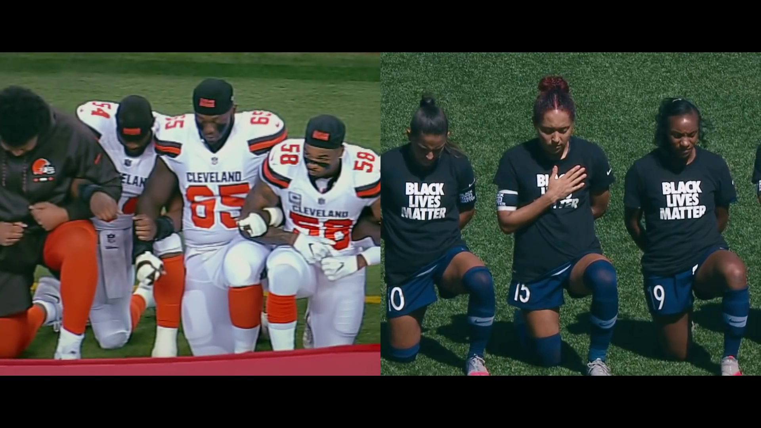
You Can’t Stop Us generates mostly positive emotions
The ad generates strong interest and inspiration throughout. Interest piques to it’s highest point at the very beginning of the ad – the first viewing of this unique editing style. Inspiration follows at key moments throughout, such as after seeing the handicapped athletes (11s), after the line “if we don’t fit the sport, we will change the sport” (31s), or during the speech for change (56s).
Interested
Inspired
Inspired
Inspired
Inspired
Inspired
Inspired
Inspired
Happy
NUMBER OF CLICKS
Inspired
Interested
Inspired
Inspired
Inspired
Interested
Inspired
Inspired
Interested
Interested
Interested
Interested
Inspired
SECONDS
12
Moment by Moment
Base: Total (n=158)

Slide 13
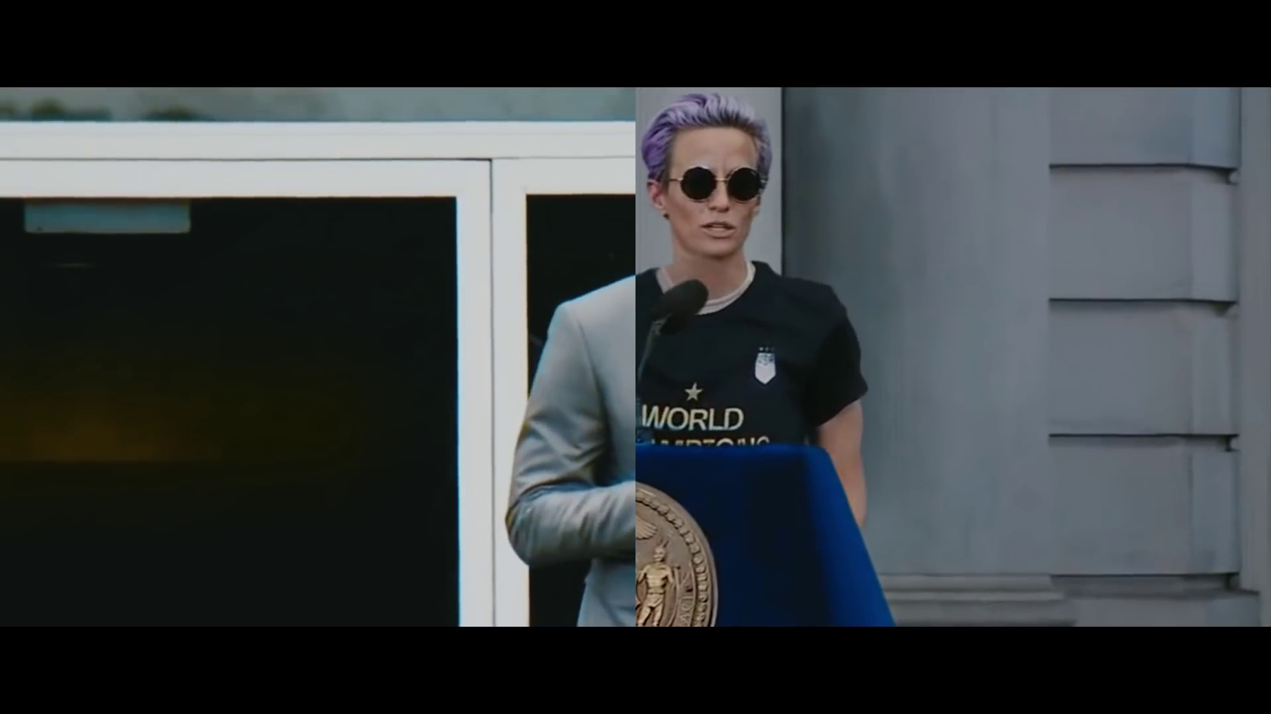
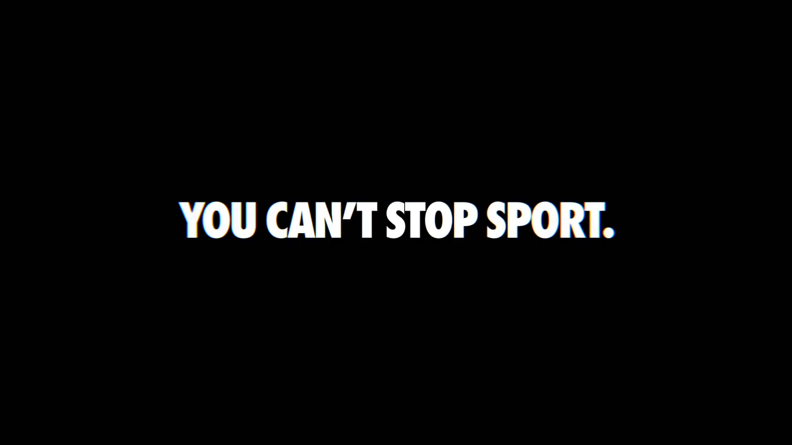
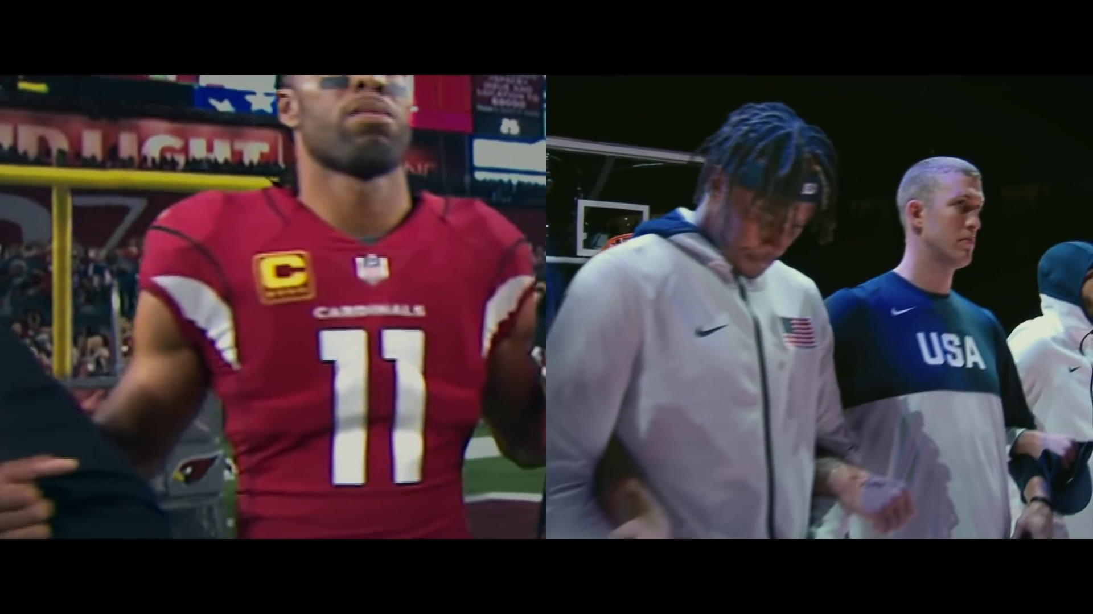
You Can’t Stop Us generates only few negative emotions
There is a spike in annoyance at 51s, where the athletes are seen kneeling. The open ended responses (slide 10) revealed that 1 in 10 find this action to be disrespectful to the American flag.
Annoyed
Annoyed
NUMBER OF CLICKS
Annoyed
Annoyed
Annoyed
Annoyed
SECONDS
13
Moment by Moment
Base: Total (n=158)

Slide 14
Message Take-Out
14

Slide 15

Message Take-Out You Can’t Stop Us
Most understood the ad, with the main takeout being to work together in this difficult time, not to give up and that sport and Nike will continue to help the community. However, the complexity and low branding of the ad causes some to misinterpret the key messages, for example, to instead be a general COVID-19 ad or to have political motivations.
 | You Can’t Stop Us
Correct Message | 69%
We are all in this difficult times together/will come out stronger/working together | 30%
You can’t stop us/sport / Sport never stops / Nike supports teams/sports/ Nike is inclusive/equal | 18%
Never give up/we can do this/everything will be okay/life goes on | 13%
We are equals/against social injustice | 10%
Sports unite everyone/connects people/we can get over this through sports | 6%
Sports will help us overcome adversity/come back as it was | 5%
Everyone can still enjoy sports/anyone can do it/you can enjoy sports anywhere | 1%
COVID situation mentions | 7%
Buy Nike | 6%
Political motivations of ad / underlying negative political reasons | 5%
Black Lives Matter / BLM Mentions | 2%
Other | 7%
Don’t Know | 2%
“With co-operation and determination anything is possible.”
70%+ Benchmark
“Whatever happens, we stand together, and sport continues.”
“Everyone help one another and come together to fight a good cause.”
“The ad wanted to show that many people face challenges but are still able to persevere by working together.”
“Sport can’t be stopped.”
“Unity and competitive spirit.”
15
O3: What is the main idea the ad is trying to get across?
You Can’t Stop Us (n=158)

Slide 16
Bonding to Nike
The ad will work to strengthen brand perceptions and improve positive feelings and connection towards Nike. People are able to relate to this ad and believe Nike is the right brand for them.
BRAND BONDING
Brand Bonding
People relate to this ad and believe what it is saying – likely driven in part by the strong casting of professional athletes and everyday people.
Addressing COVID-19 and social movements (such as racial injustice) create strong feelings of empathy, creates a sense that this is a brand for them and suits the needs and lifestyles of most.
This ad works well to drive purchase consideration, encouraging people to buy Nike and they will likely feel positive for shopping there.
The ad could do more to provide new information about Nike and further differentiate themselves from other brands.
Effectiveness
Threshold
6.0
Bonding Diagnostics
Effectiveness
Threshold
6.0
Are the ideas relevant?
Does it drive consideration?
Does it suit their needs and lifestyle?
Do people empathise with the ideas shown?
Do people feel it is a brand for them?
Does it tell people something new?
Is it different to other brands?
Do people believe the ideas in the ad?
Source: Add+Impact Attention Ratings *Note: Results shown are not means, they are standardised factor scores.
16
Base: Nike You Can’t Stop Us (n=158)

Slide 17
Likeability & Intent
This ad is very likeable with a majority agreeing they like the ad very much. Similarly, this ad will help drive purchase consideration: 2 thirds are likely to purchase Nike products after seeing this ad.
Likeability
Purchase Intent
77%
59%
Like very much/Like
Definitely/Probably Buy
Source: Q1 Which statement best describes how you feel about the advertising?
Source: Q33 How likely are you to purchase Nike products?
17
You Can’t Stop Us (n=158)

Slide 18
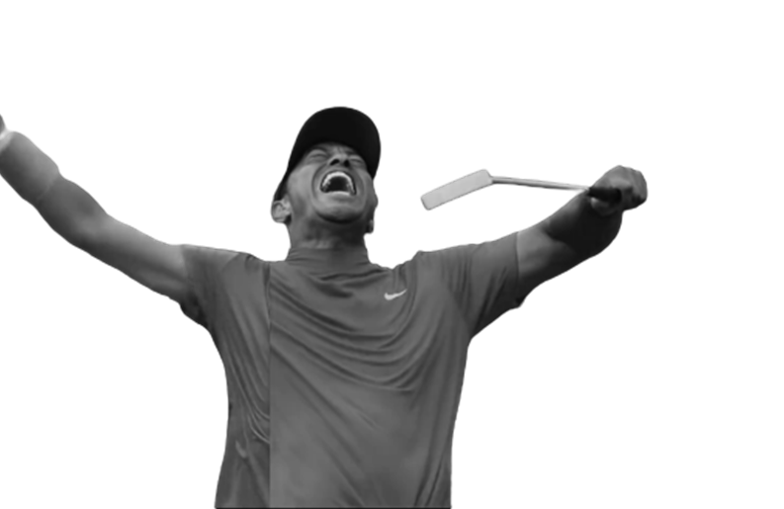
Brand Integration
Just over 8 in 10 are able to correctly identify Nike as the advertising brand. It is possible that the complexity of the ad, unfamiliar editing style, the strong social justice storyline (not directly linked to Nike) and weak brand cues (only showing logo on uniforms, no written or verbal mention of brand name etc.) are driving the lower than benchmark prompted and spontaneous branding.
Prompted Branding
Spontaneous Branding
 | You Can’t Stop Us
Correct Brand Mentions | 81%
Nike | 81%
Other | 9%
Don’t know | 10%
12%
Nike
30%+ Guideline
95% Benchmark
“An inspirational ad about sports that it sponsored by Nike.”
“Nike says sports can save society.”
“Nike loves to put the best athletes in their videos.”
O2: What is the name of the brand being advertised? (Prompted Branding)
O1: What thoughts, ideas & feelings did you have when you watched this ad? (Spontaneous Branding)
You Can’t Stop Us (n=158)
18

Slide 19

Summary
You Can’t Stop Us was found to be highly engaging, attracting attention through the use of high-profile athletes and inspirational music. However, people struggled to find the link to Nike, with some suggesting it could be an ad for anyone. Others felt it was more of an attempt to push a political agenda than advertise their brand.
Strengths
Wearout on the ad is low, meaning people are likely to continue to enjoy watching the ad.
The combination of the use of high-profile athletes and everyday Americans made the ad highly relatable – people were given a sense of inclusion and unity, which fits with the main messaging.
The creative editing style was well received by the audience, adding a point of difference to an ad concept that had been used before.
Opportunities
Branding was low, with some respondents thinking the ad was an attempt to tackle social issues rather than an advertisement for Nike. This gives scope for including a stronger link to Nike and its products.
Some felt the ad was too long, perhaps a shorter version with less scenes could increase attention and message takeout.
19

Slide 20
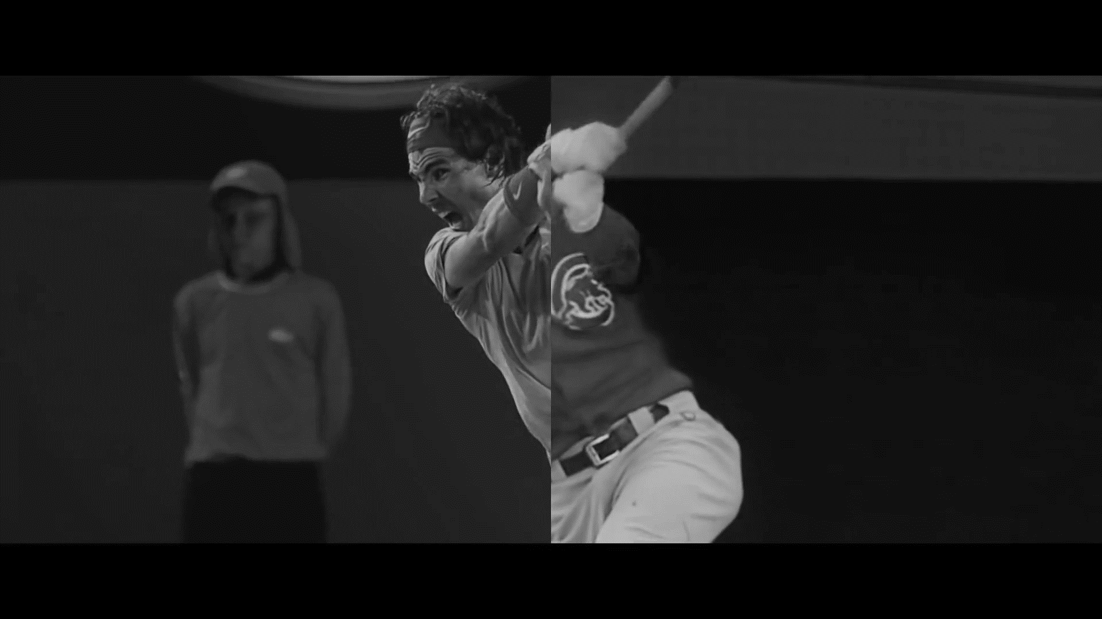

Thank you!
Please let us know if you have any questions…..or would just like to chat about this!
Sally Joubert sally@lumaresearch.com

