Slide 1
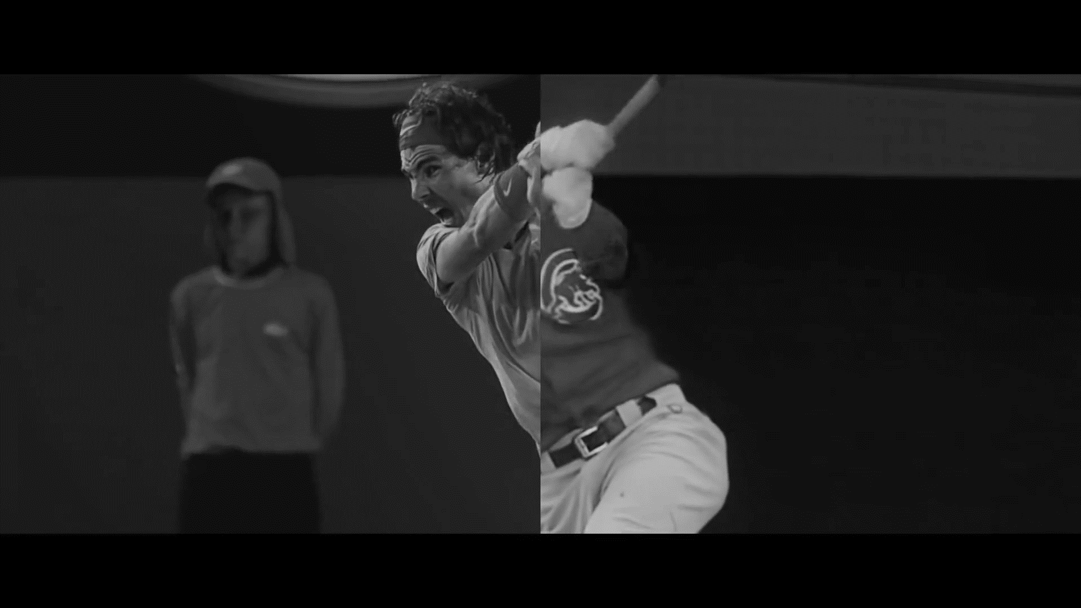

Nike: You Can’t Stop Us
Case Study Australia
August 2020

Slide 2
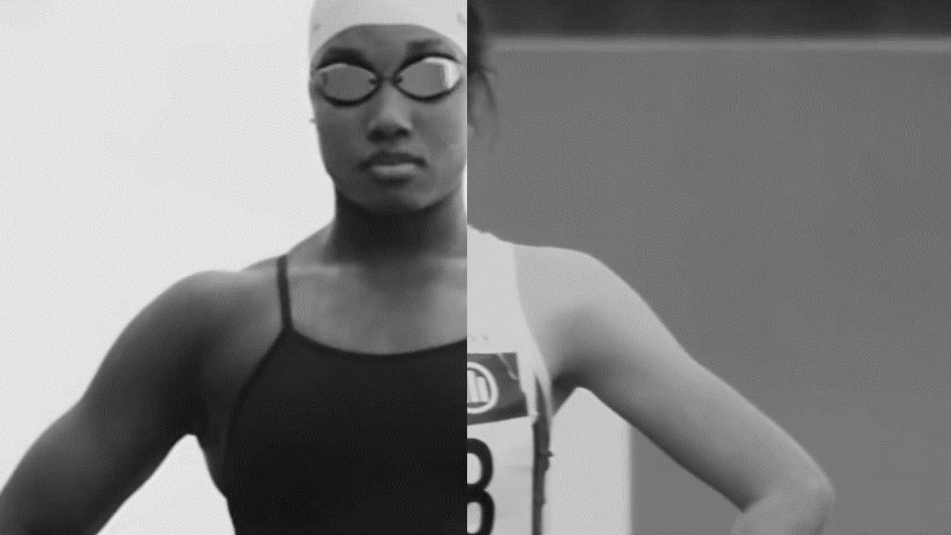
You Can’t Stop Us shows that closures haven’t stopped athletes from pushing forward and using their platforms to help create change. Nike reminds us that through a level playing field a better future is possible…

Slide 3





Nike You Can’t Stop Us Case Study
Luma surveyed a cross section of Australians about the Nike You Can’t Stop Us ad.
Invite & Screening | Exposure to ad | Undirected Questions | Prompted Ad & Brand Questions | Moment by Moment
Participants were invited & screened to ensure they met specifications. | The ad was shown twice. | After seeing the ad, participants were asked three undirected open-ended questions. | A series of closed-questions about the ad and brand were then asked. | Lastly they ad was replayed and we measured how they felt as they watched.
The Sample: n=154 Nat rep gender & age & aged 18+
Fieldwork: 5th – 6th Aug 2020
Sample Source: Lucid
3

Slide 4
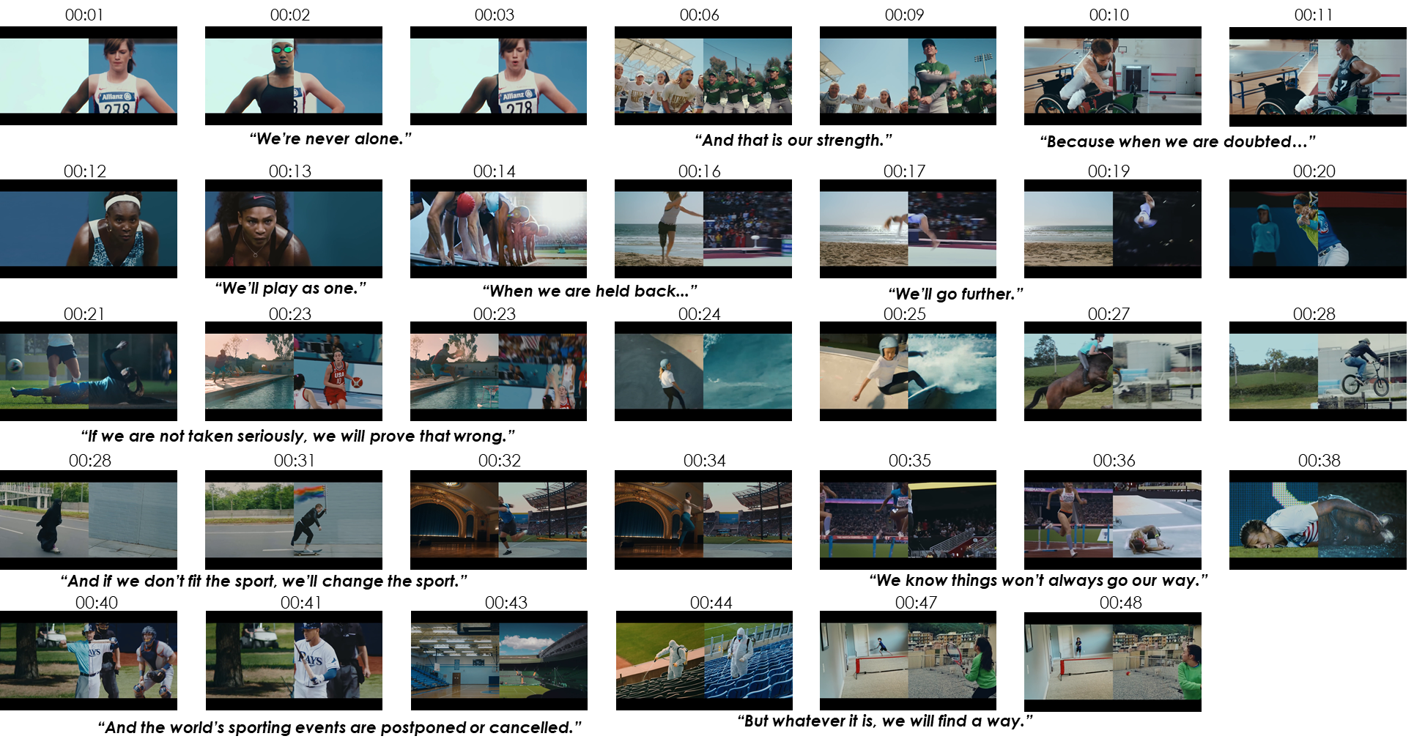
Nike You Can’t Stop Us
4

Slide 5
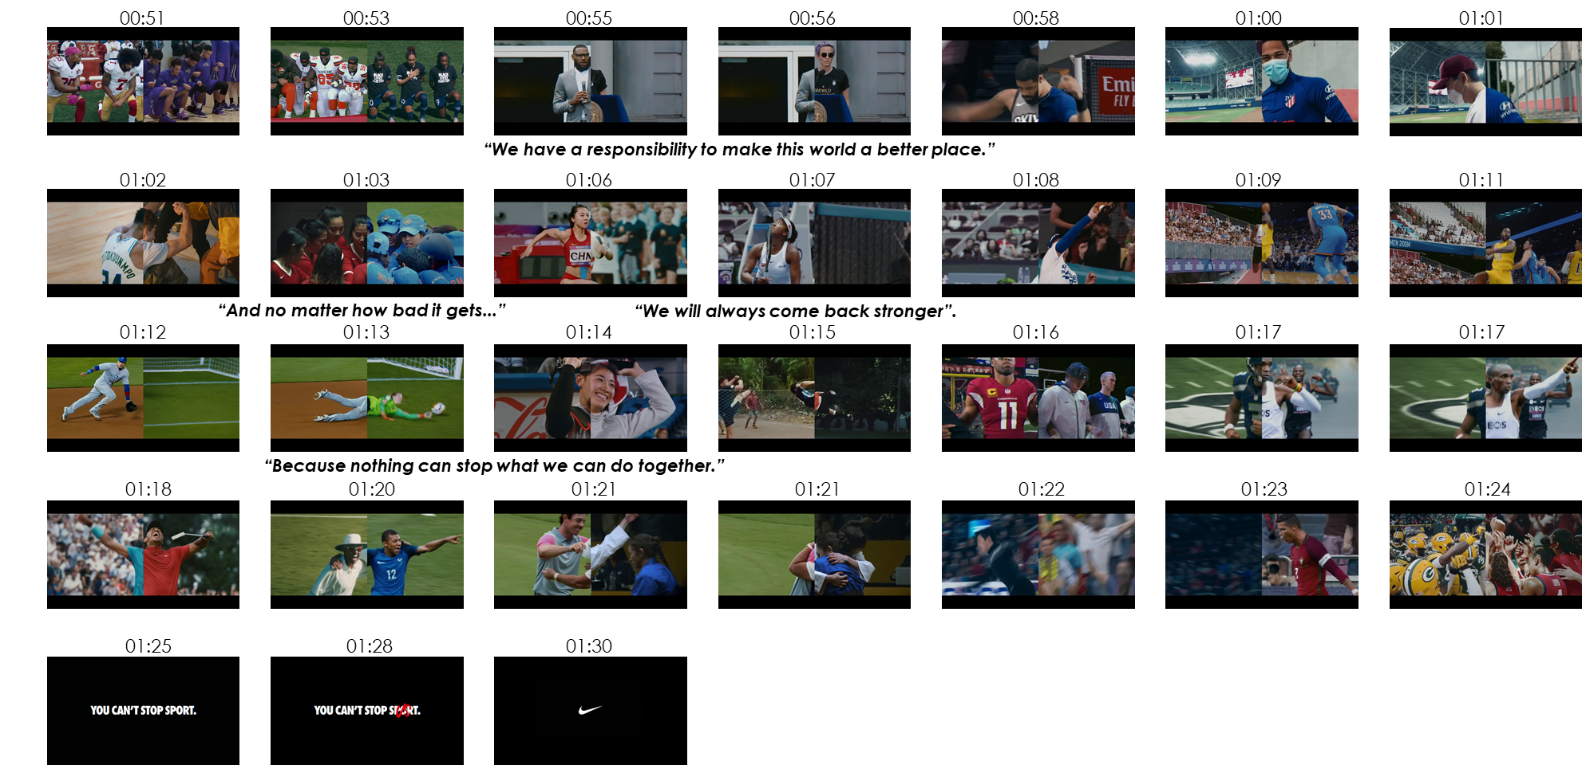
Nike You Can’t Stop Us
5

Slide 6
Making Great Ads To Grow Brands
We have been measuring ads for over 25 years and identified that to make a brand grow, you need ads which get noticed & make people feel good…
Salience
Get noticed &
Build link to brand
Feel Good
Leave people with positive feelings
Feelings have the strongest effect on consideration & driven by relevance of what you say & how you say it.
Drive through music, humour, casting, story telling & brand mnemonics.
6

Slide 7

Key Performance Metrics
You Can’t Stop Us is ground breaking, highly emotional and an instant hit on social media. The 90 second ad delivers the powerful story of perseverance and inspires hope in the face of adversity. It talks to race, gender and the idea that we are all in this together. Creatively the split screens pairing athletes and sports, is unique and engaging and leaves people feeling positive about Nike. There is an opportunity to improve branding which is below benchmark.
 | Effective Benchmark | You Can’t Stop Us (Australia)
Ad Attention Will the ad get noticed? | 6.0 | 6.6
Message What does the ad convey? | 70% | 76%
Bonding How does it make people feel? | 6.0 | 7.1
Branding Is the link clear? | 95% | 83%
add+impact® Effectiveness Score How does it compare to other ads? | Top Quartile | Top 29% of all 8000 Global Ads
✓
✓
✓
7
✓
Meets Effectiveness benchmark.
7

Slide 8
Attention You Can’t Stop Us
The ad will cut-through and be noticed. It is seen as original and memorable and keeps people entertained. One third claim they will share it online.
Cut Through Potential
Strengths
You Can’t Stop Us is entertaining and likeable.
People love watching it and it is showing no signs of wearing out.
The elite and everyday athletes work well – they are suitable and well liked.
Opportunities
Some feel there are too many scenes making the 90s ad hard to follow - there is an opportunity is to use cut-down versions.
Xxx
xxx
Effectiveness
Threshold
6.0
32%
will share online
Creative Strengths & Weaknesses
Effectiveness
Threshold
6.0
Will people watch on future exposures?
Do people like the ad?
Are people tired of seeing it?
Are the people well-suited to the ad?
Do people like the music?
Are there too many scenes/ideas in the ad?
Is the ad easy to understand?
Source: add+Impact Attention Ratings *Note: Results shown are not means, they are standardised factor scores.
8
Base: Nike You Can’t Stop Us (n=154)

Slide 9
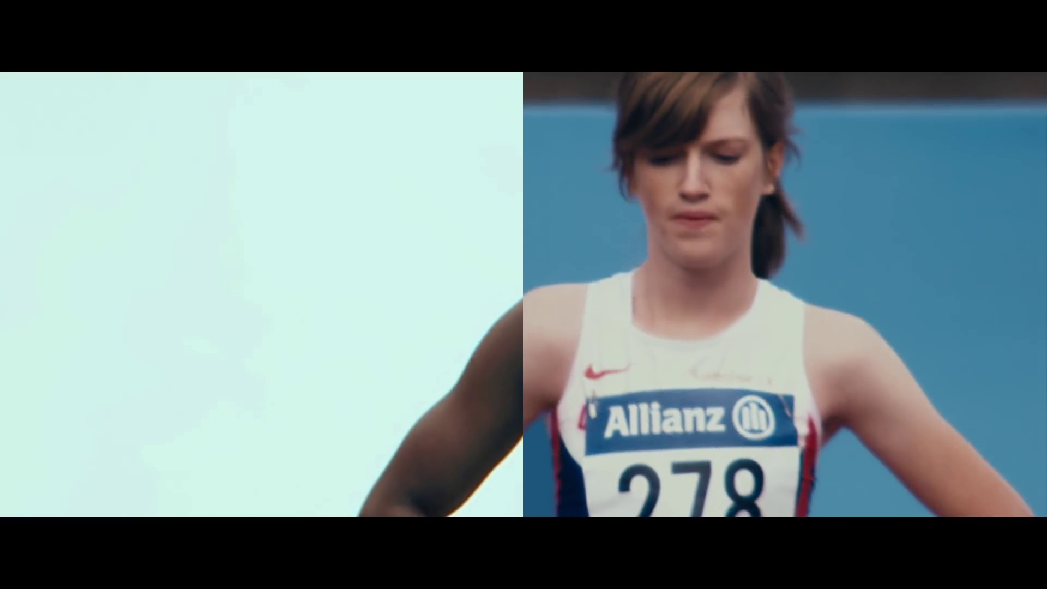
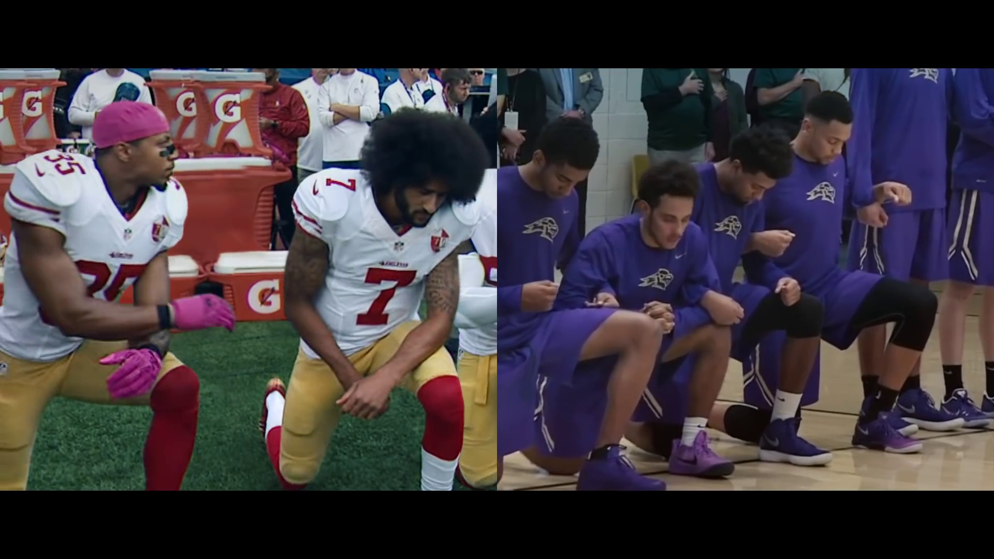
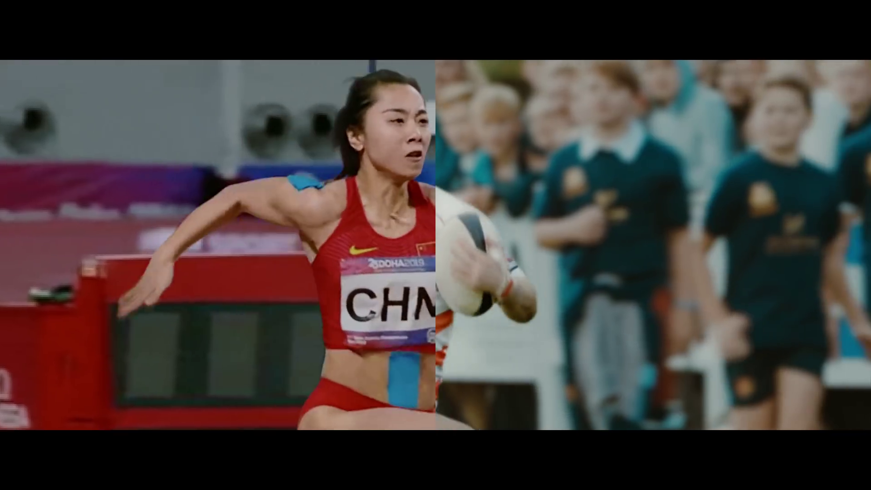

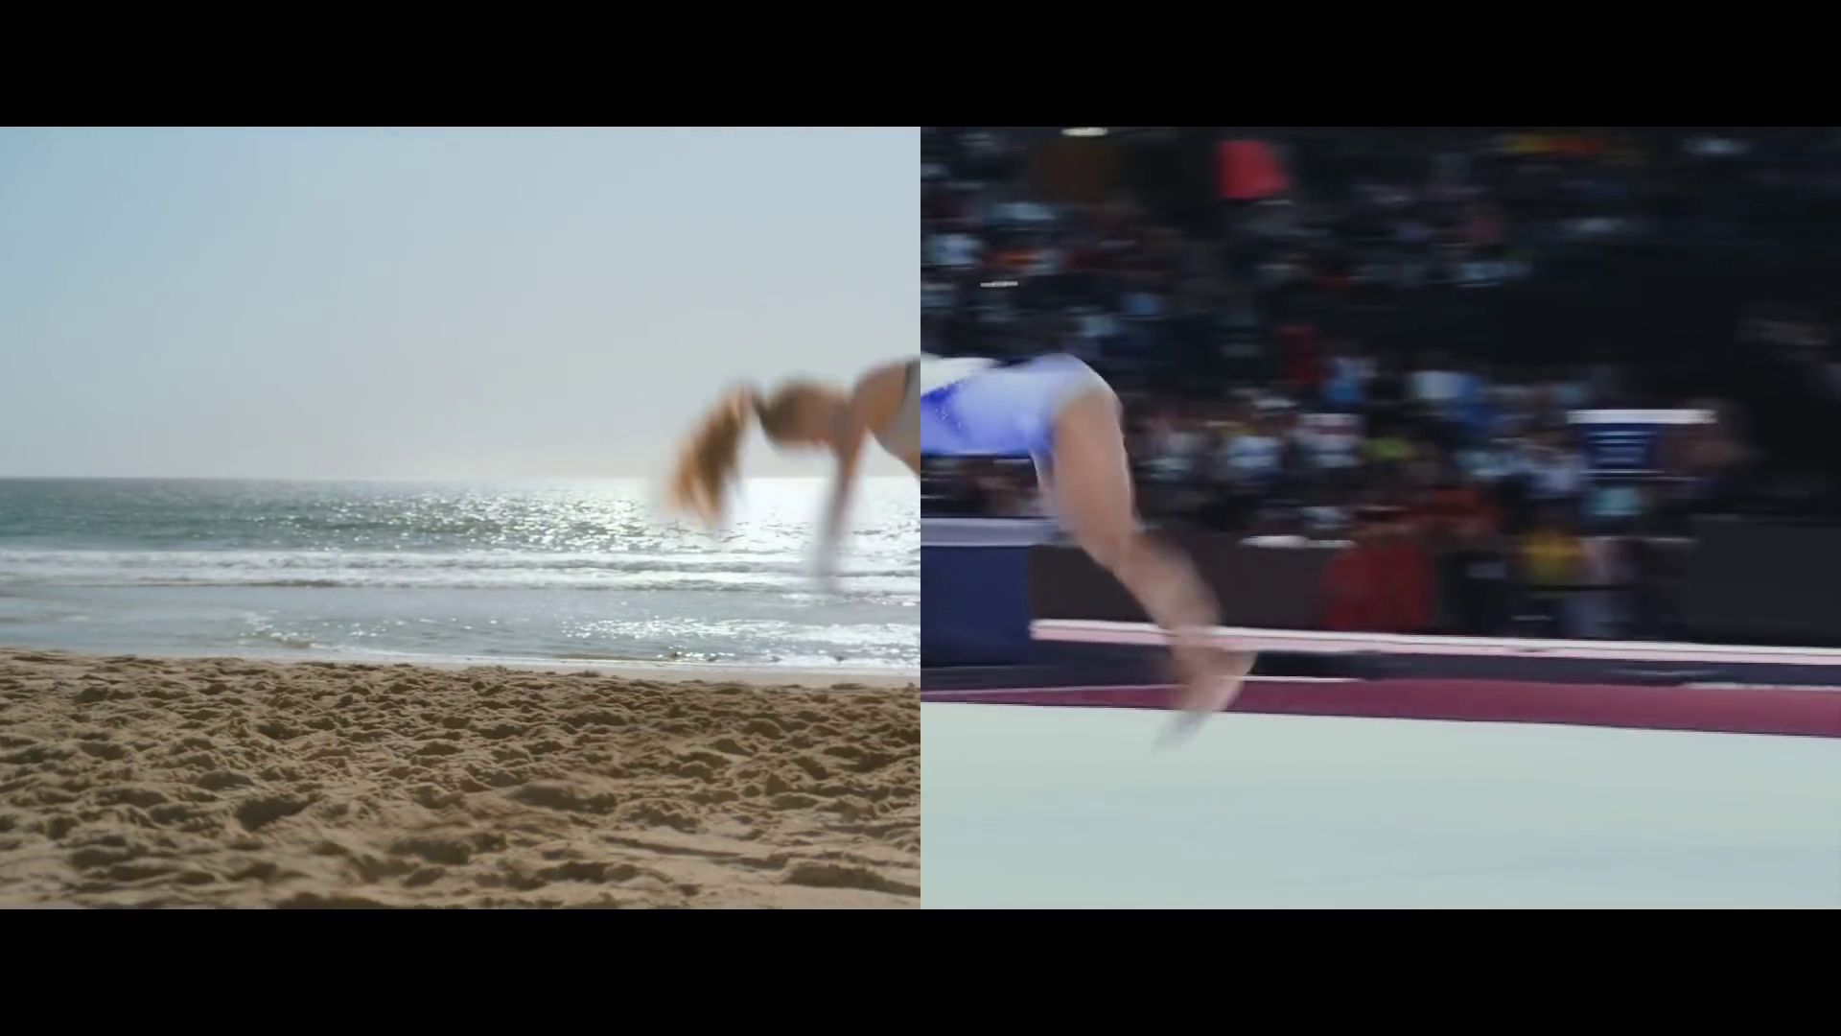
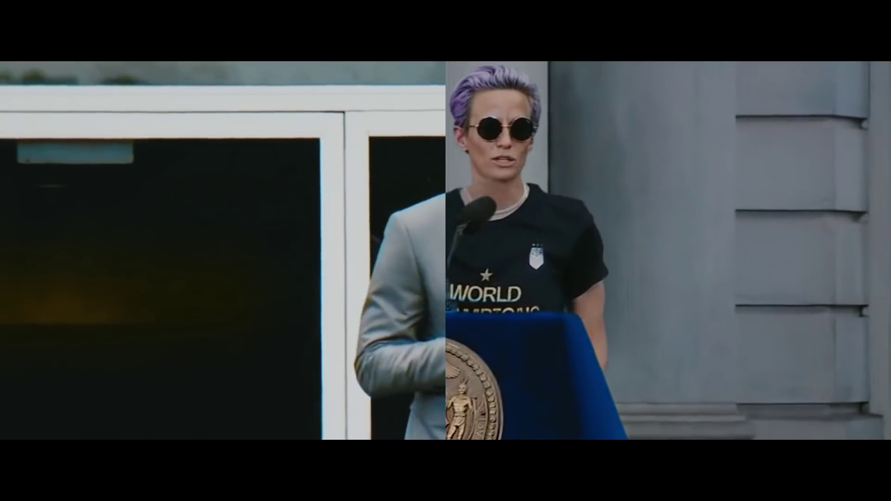
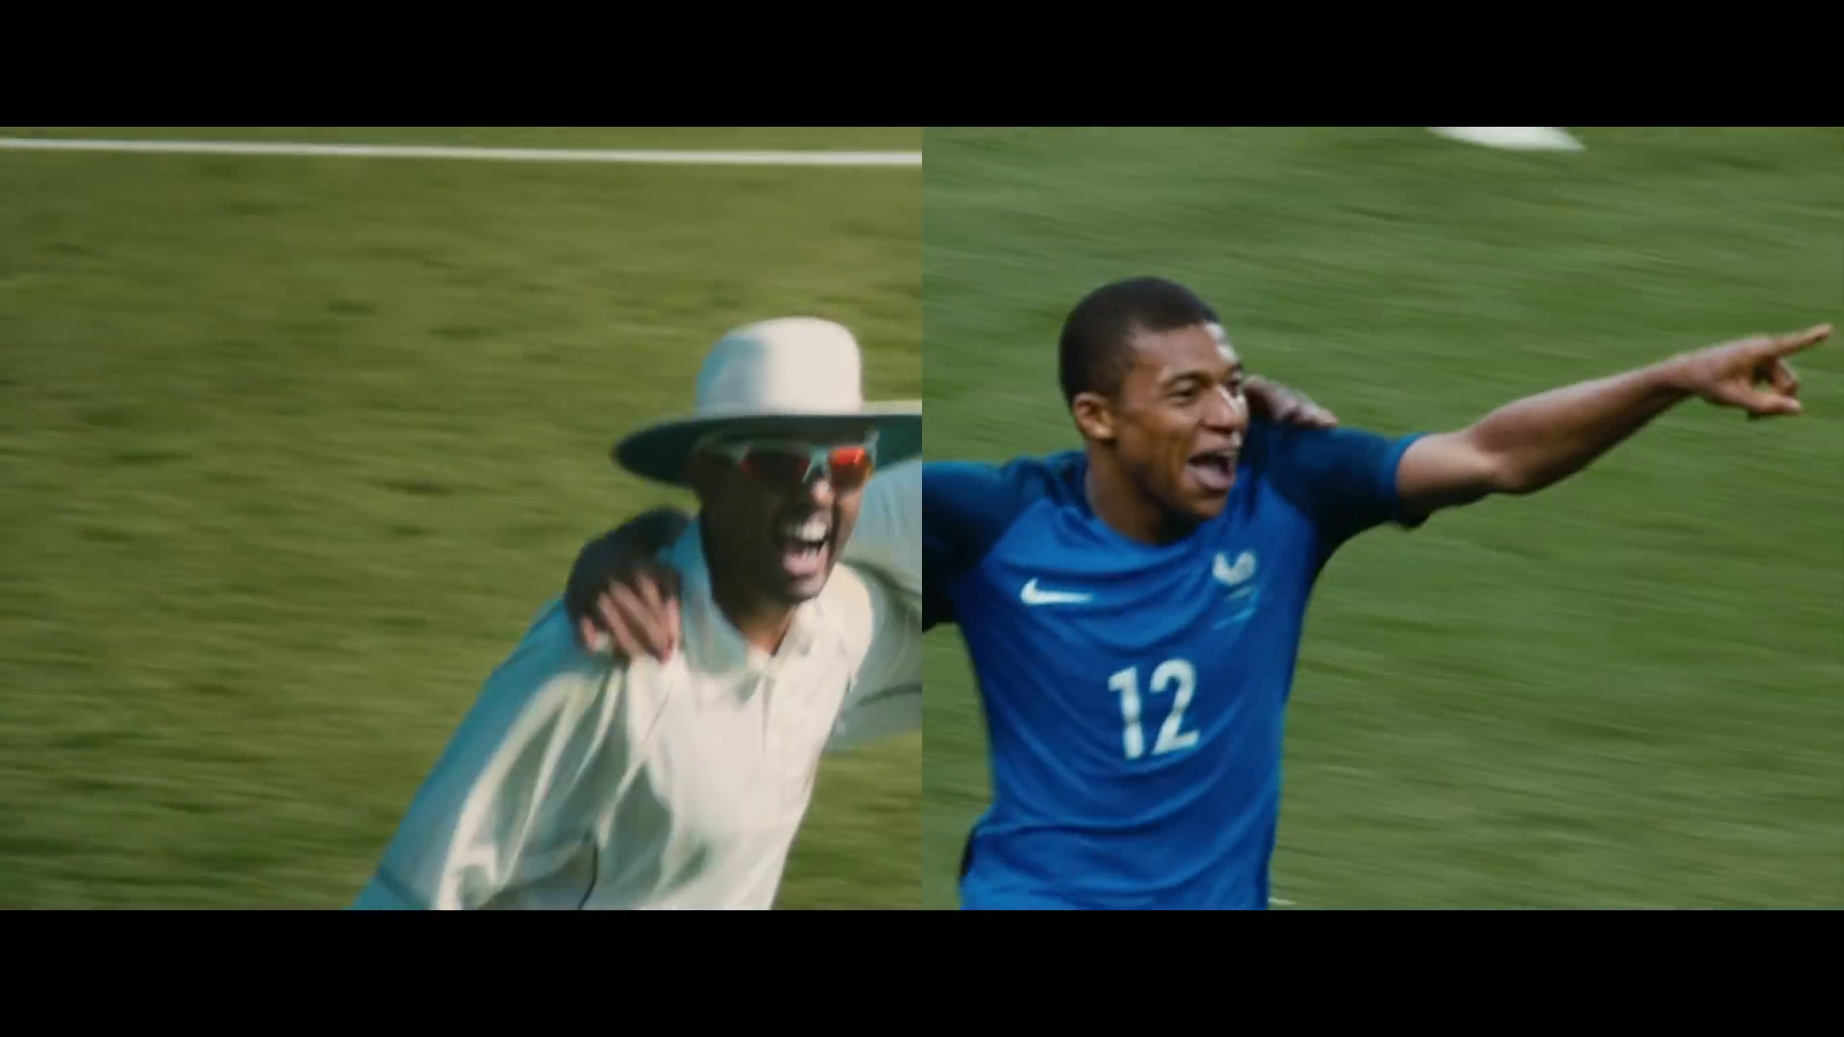
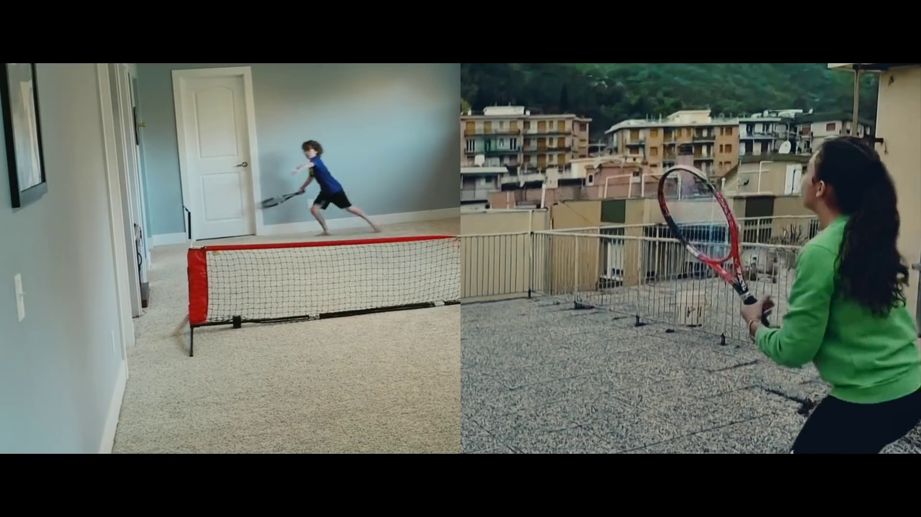
You Can’t Stop Us generates positive emotions
The ad inspires and interests viewers consistently throughout. Interest peaks at the beginning, with the viewers being attracted to the unique visuals. Inspiration peaks as new athletes/scenes are introduced and the story about trying harder and making the world a better place is told.
“We’ll play as one.”
“We have a responsibility to make this world a better place.”
“We will always come back stronger”.
“When we are held back...”
“We’ll go further.”
Interested
“And harder.”
Inspired
Inspired
Inspired
Inspired
NUMBER OF CLICKS
Interested
SECONDS
Moment by Moment
Nike (n=154)
9

Slide 10
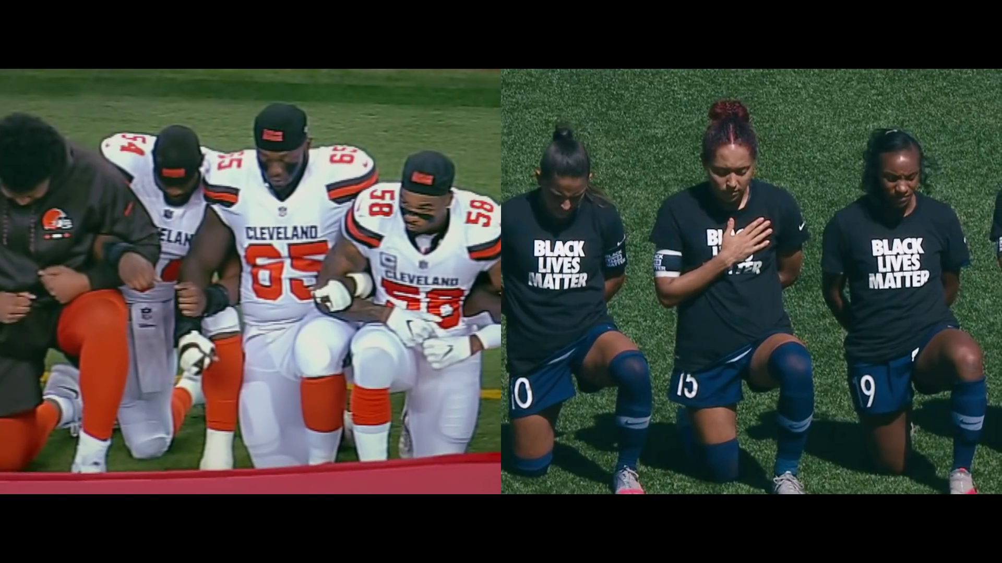
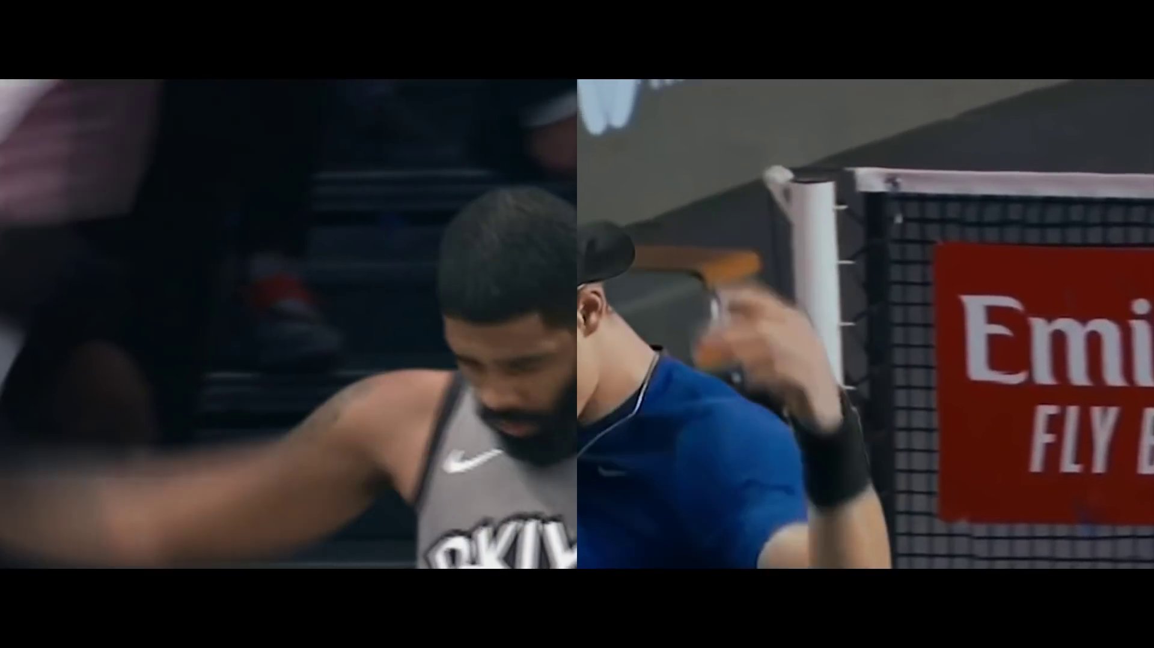
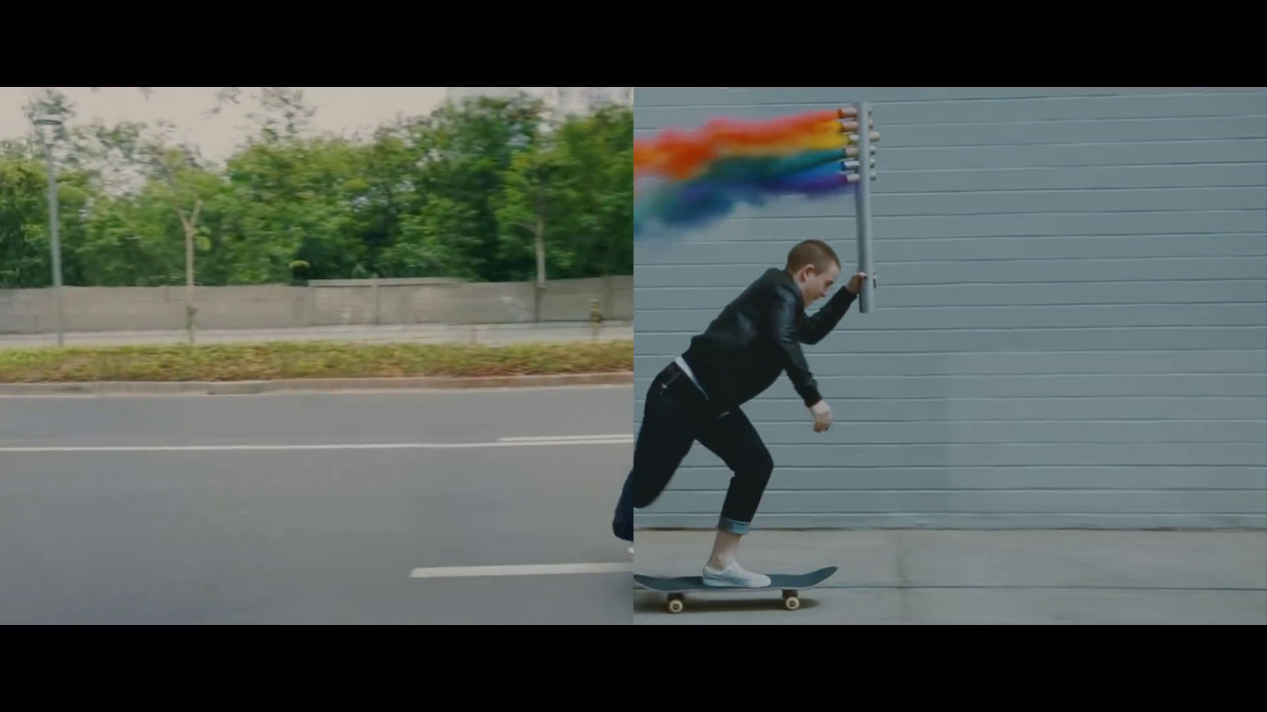
You Can’t Stop Us generates few negative emotions
The ad generates few negative emotions – some confusion around ‘changing the sport’ and some annoyance at the athletes kneeling.
“And if we don’t fit the sport, we’ll change the sport.”
Annoyed
Annoyed
NUMBER OF CLICKS
Confused
SECONDS
Moment by Moment
Nike (n=154)
10

Slide 11

Message Take-Out You Can’t Stop Us
The message is well communicated. The ad highlights the common goals and experiences shared by athletes around the world with the majority talking about support and diversity through sport
“We can do it all together.”
 | You Can’t Stop Us
Correct Message | 76%
You can't stop sport/us/sport never stops | 19%
Nike/sports is inclusive/equal | 10%
Nike supports sports/teams through difficult times | 5%
Sports unite everyone/connects people/we can get over this through sports | 8%
Everyone can still enjoy sports/anyone can do it/you can enjoy sports anywhere | 8%
Never give up/we can do this/everything will be okay/life goes on | 8%
Sports will help us overcome adversity/come back as it was | 6%
Other | 11%
Don’t Know | 4%
70%+ Benchmark
“Sport is important.”
“Resilience and diversity in sports.”
“We stand together regardless of the challenges we face.”
“We can do anything we want to do.”
“You can’t stop sport.”
O3: What is the main idea the ad is trying to get across?
Nike You Can’t Stop Us (n=154)
11

Slide 12
Bonding to Nike
The ad helps to build positive brand feelings for Nike. It works well both emotionally and rationally and leaves people feeling good about Nike.
BRAND BONDING
Brand Bonding
Effectiveness
Threshold
6.0
People feel that Nike is a brand for them and are highly likely to be persuaded to consider the brand.
Emotionally, people feel that Nike suits them and feel connected to the brand because of the ad.
Rationally, the ad tells them something new and different which is highly believable.
Bonding Diagnostics
Effectiveness
Threshold
6.0
Are the ideas relevant?
Does it drive consideration?
Does it suit their needs and lifestyle?
Do people empathise with the ideas shown?
Do people feel it is a brand for them?
Does it tell people something new?
Is it different to other brands?
Do people believe the ideas in the ad?
Source: add+impact® Brand Bonding statements. *Note: Results shown are not means, they are standardised factor scores
12
Base: Nike You Can’t Stop Us (n=154)

Slide 13
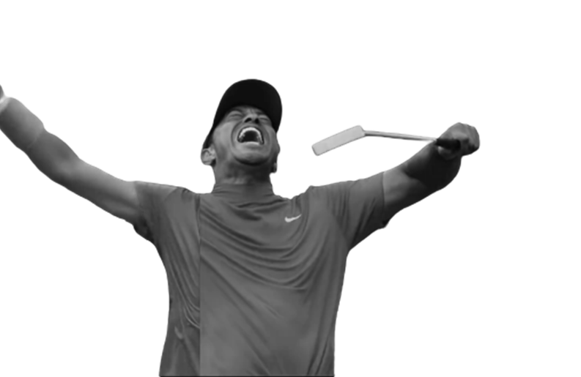
Brand Integration
Branding is not strong compared to benchmark – four-fifth were able to recall the ad was for Nike. A tenth mentioned Nike spontaneously suggesting that the Nike brand is not as integrated into the film as it could be.
Prompted Branding
Spontaneous Branding
 | You Can’t Stop Us
Correct Brand Mentions | 83%
Nike | 83%
Adidas | 3%
Other | 4%
10%
Nike
30%+ Guideline
95% Benchmark
“Nike helps with sport.”
“Nike will be there after COVID-19.”
“Nike is supporting sports.”
O2: What is the name of the brand being advertised? (Prompted Branding)
O1: What thoughts, ideas & feelings did you have when you watched this ad? (Spontaneous Branding)
Nike You Can’t Stop Us (n=154)
13

Slide 14

Summary
Strengths
You Can’t Stop Us is an effective ad. It is original, memorable and people want to keep watching it. Showing a multitude of sports and both elite and everyday athletes in such a compelling and clever way attracts viewers to watch and share.
The message is clear that Nike supports diversity and sports. People understand it is a brand for all and nothing will stop that.
The message is highly emotional and well received leaving people feeling empowered. People feel very positive about Nike and see it as a brand for them. Nike’s message is credible and strongly differentiates the brand.
Opportunities
Branding can be improved – consider including more obvious distinctive brand cues.
14

Slide 15

Thank you!
Please let us know if you have any questions…..or would just like to chat about this!
Sally Joubert sally@lumaresearch.com

