Slide 1
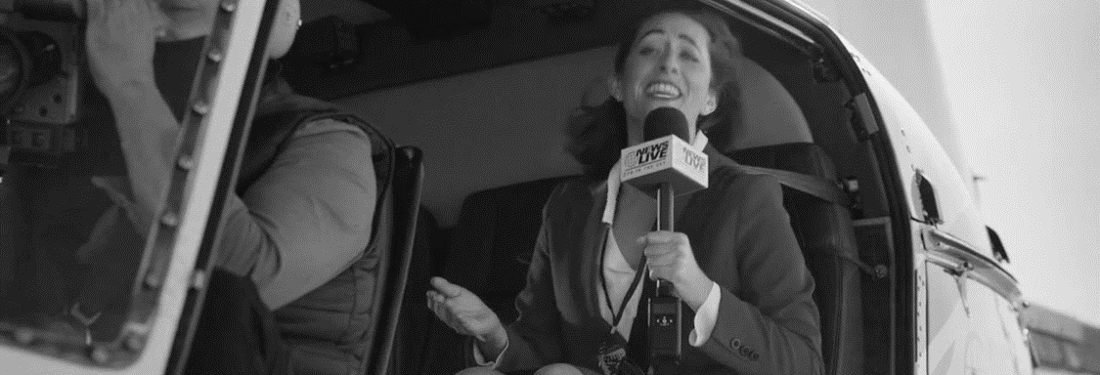
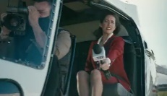
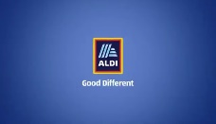

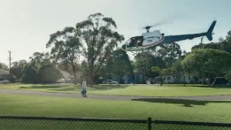


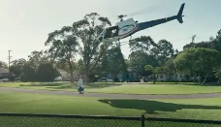

49%
add+impact®
Effectiveness Score
Advertising Insights
Aldi Helicopter
See Full Report Here
Aldi’s Helicopter is effective particularly when compared to other retail ads.
Why?
It delivers its message in a fun and positive way. Creatively it is engaging and get’s people attention. The intended message about value is clearly conveyed. The ideas are relatable and so the ad leaves people feeling good about Aldi and 70% claim they will shop there. The link to Adi is clear.
Top
28%
Of All Retail Ads
Top
38%
Of All Global Ads
Ad Attention Will the ad get noticed? | 6.0 Retail ads range from 4.9 – 8.5 | 6.2
Bonding How does it make people feel? | 6.0 Retail ads range from 5.7 – 9.7 | 7.4
Message What does the ad convey? | 70% | 88%
Branding Is the link clear? | 95% | 95%
Shopping Intent Will they consider Aldi? | 54% | 70%
See Ad Here
Number of Clicks
Seconds

