Slide 1


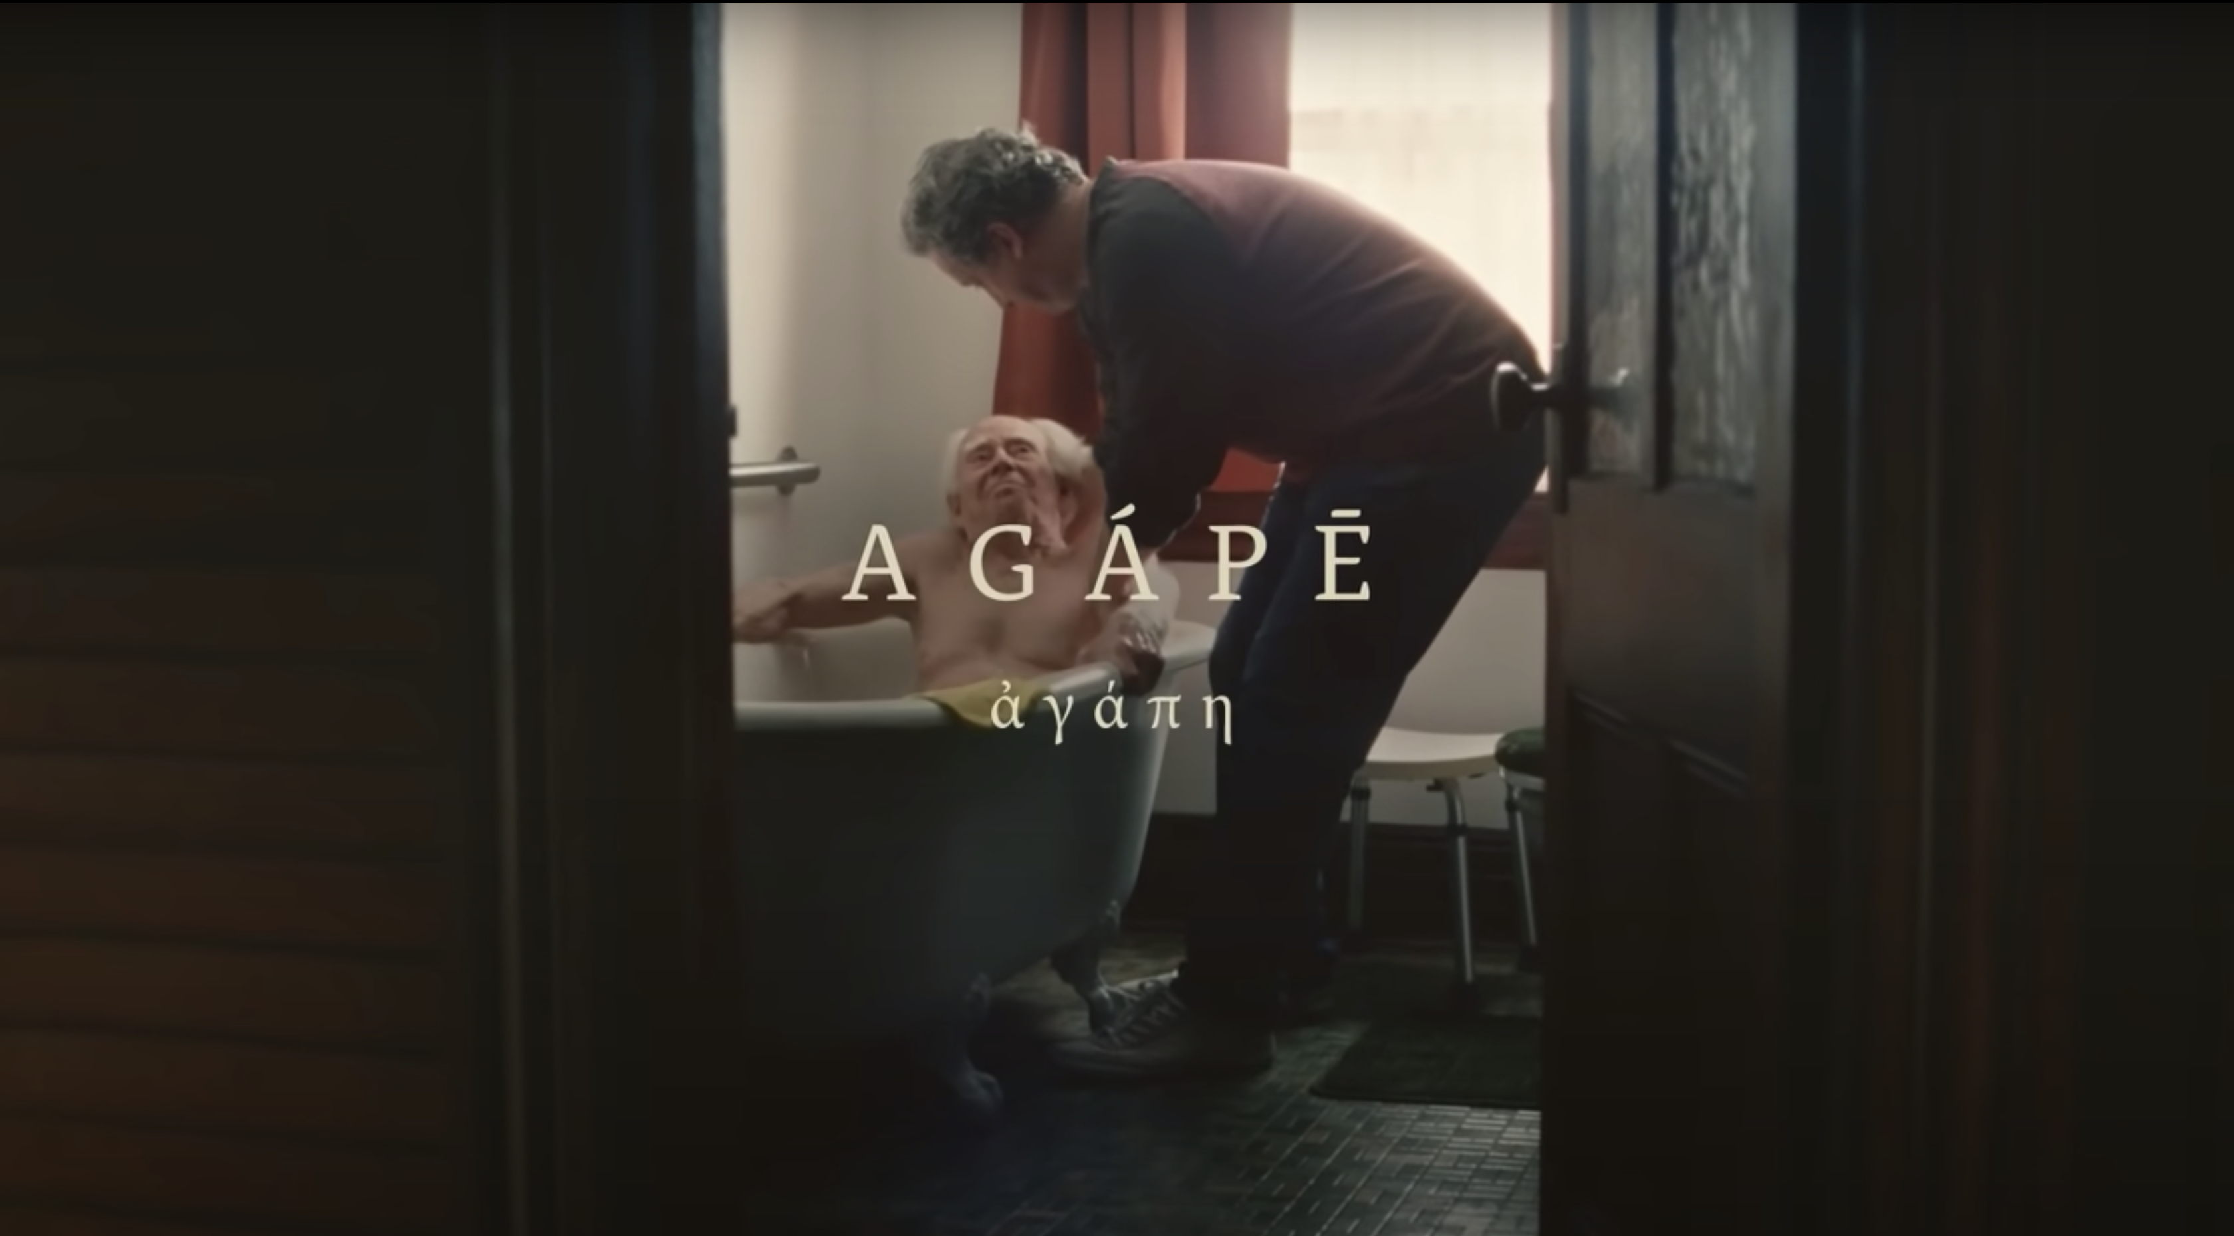
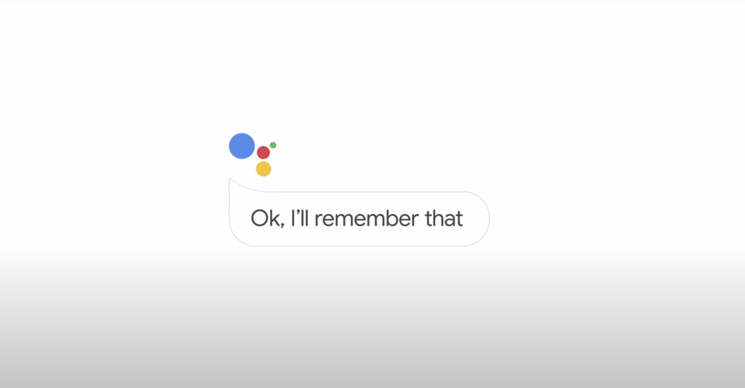

COVID-19 Advertising Insights April 20
COVID-19 has rapidly transformed every aspect of human function on a global scale. Advertising during a crisis is crucial, but it is a real challenge to get it right.
Background
Luma has been researching people’s thoughts and feelings about advertising from the initial COVID lockdown through to the easing restrictions.
We re-tested a range of ads to see what had changed and tracked feelings and attitudes to brands. We also did some qualitative research to understand the mood,.
We used our 2020 Super Bowl Study as a control cell and our add+impact® methodology to measure key metrics and brand perceptions.
We also asked some COVID-19 related questions to see how consumers feel about advertising during the pandemic

Slide 2
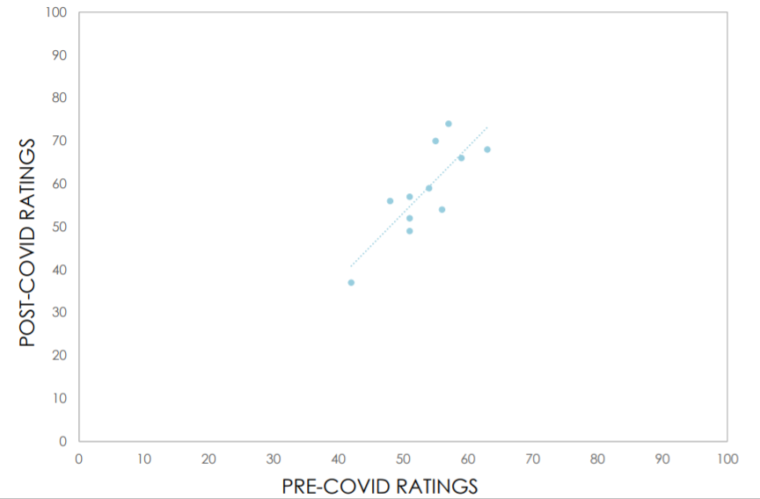
Key Findings
Consumers in April 2020 remain receptive to advertising, particularly in the US. Most want to see advertising that is relatable. Being able to connect with your customers is more important than ever.
 | AU Avg | UK Avg | US Avg
It is important that brands continue to advertise during COVID-19 | 84% | 75% | 87%
During COVID-19 I want brands to show they understand how I am feeling | 86% | 80% | 88%
add+impact® ratings show people are responding to ads in a similar way…
Luma re-tested ads to see how they were going in the campaign, and we found responses were much the same.

Slide 3
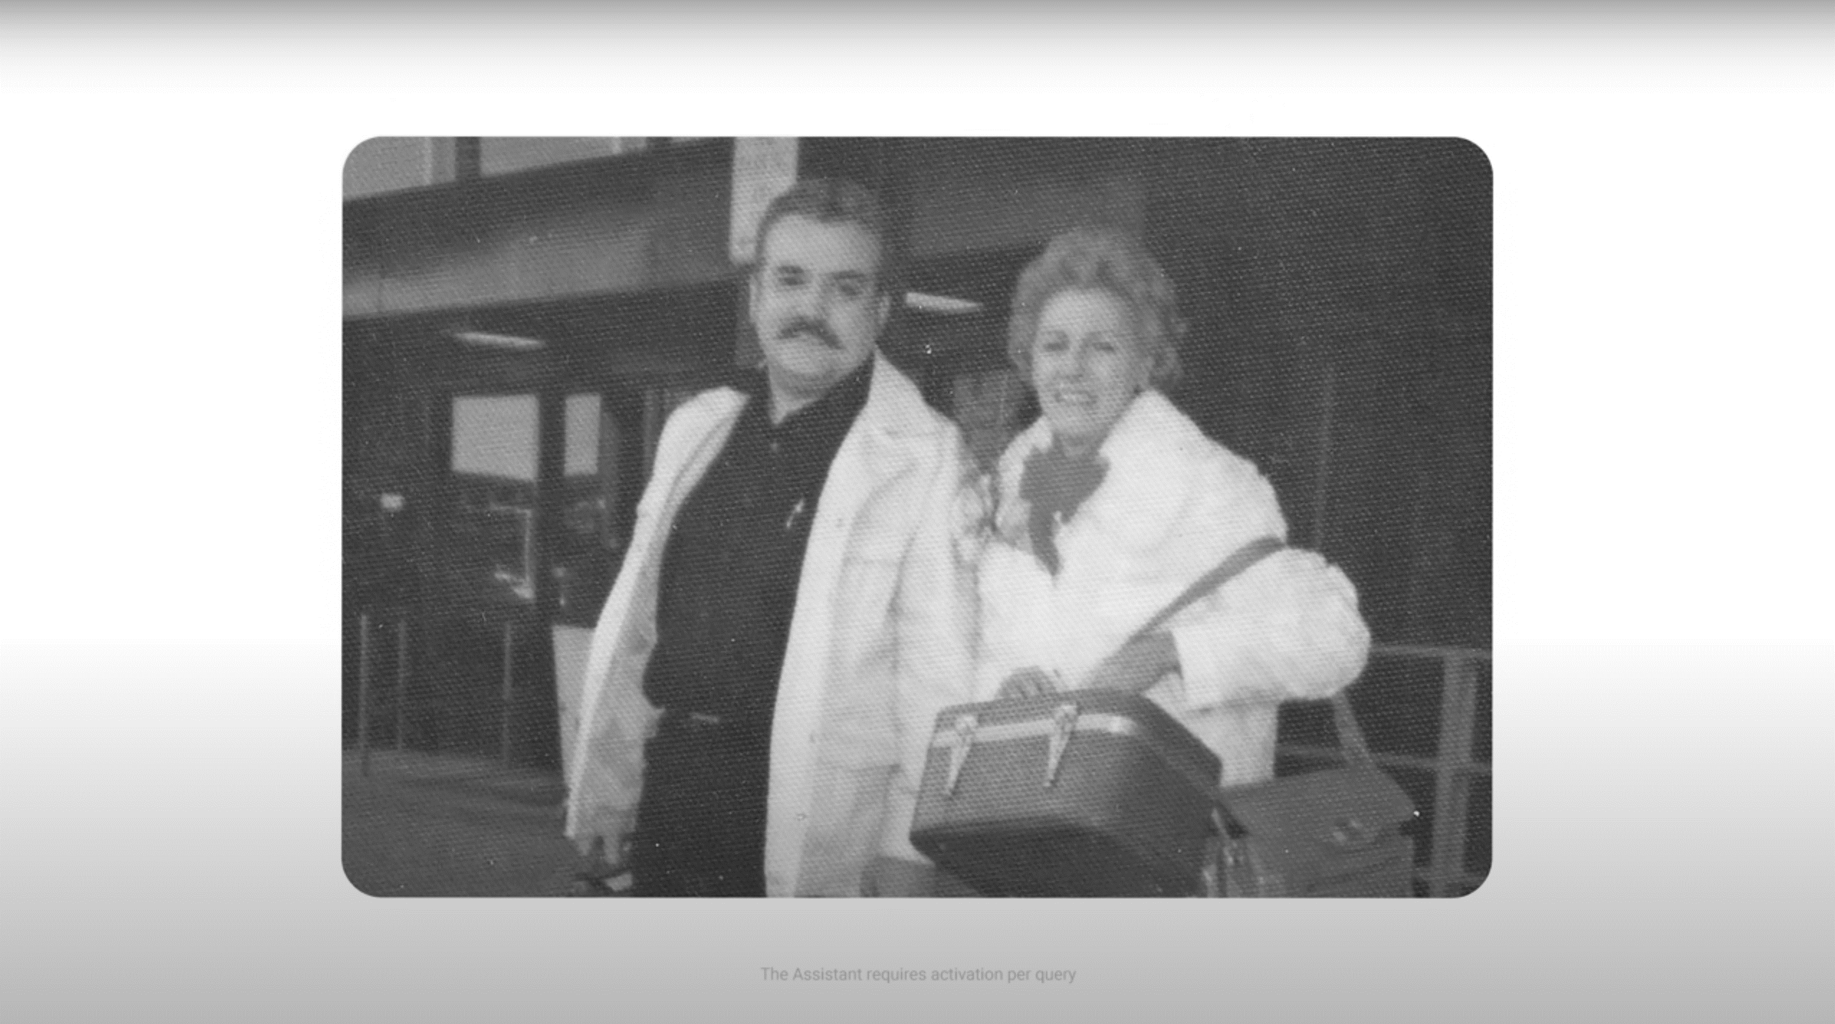


Google ’Loretta’
Using our add+impact® creative test we re-tested the Google Assistant ad ‘Loretta’ to see if consumers views had changed from Feb to April. We were really interested to see if it was as effective during COVID-19 as it was when launched at the Super Bowl in Feb 2020.
Key Findings
Loretta is as effective as it was before the pandemic.
ATTENTION
Will the ad get noticed?
BONDING
Does it strengthen brand feelings?
6.0
6.8
6.9
6.0
7.5
7.4
BENCHMARK
April 2020
BENCHMARK
Feb 2020
April 2020
Feb 2020
This highly emotional spot creates empathy and continues to generate strong brand feelings. The message is simple and relevant and people continue to relate well to the people.
Attention Diagnostics
Strengths & Weaknesses
Bonding Diagnostics
What is driving Brand Feelings?
AD EFFECTIVENESS BENCHMARK = 6.0

Slide 4
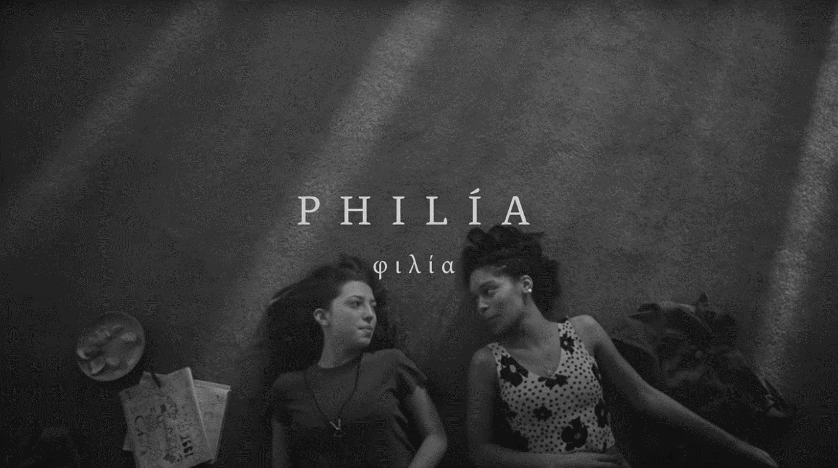
New York Life ’Love Takes Action’
Using our add+impact® creative test we also re-tested the New York Life ‘Love Takes Action’ to see if consumers views had changed from Feb to April.
Key Findings
This highly emotive ad, which delves into different types of love is still highly engaging.
ATTENTION
Will the ad get noticed?
BONDING
Does it strengthen brand feelings?
6.0
6.6
6.7
6.0
6.6
7.1
BENCHMARK
April 2020
BENCHMARK
Feb 2020
April 2020
Feb 2020
The message is now more relevant and persuasive. The virus is touching everyone and at this time people are thinking about the profound impact it is having on their the lives
Attention Diagnostics
Strengths & Weaknesses
Bonding Diagnostics
What is driving Brand Feelings?
AD EFFECTIVENESS BENCHMARK = 6.0

Slide 5

Qualitative to Delve into the COVID Mood
Most demographic groups wanted to see ads that made them feel more positive about the pandemic.
Young
Singles
Young
Families
Bored of restrictions on lifestyle
Looking to stay connected
Resentful of brands tempting them to spend on things they can’t afford
Juggling work and home-caring young children
Worn down and tune out bad news
Looking for ‘me-time’ and escapism
Older
Families
Empty
Nesters
Enjoying increased family time
Undercurrents of uncertainty about their financial futures
Tune-out to uninspiring advertising, looking for positive messaging and imagery
The most conscious of impacts on the global economy, having lived through the GFC and recession
Wanting brands to take-action. Expect resurgence in ‘Australian made’ and ‘supporting local business’
Recommendations
Overall, there has been little change in consumer attitudes to advertising.
Humour is still popular and many consumers see it as comic relief from the grey reality of COVID-19. More humour-related info here.
Be invested in how consumers are feeling – connecting with their feelings will do even more for the brand now than during more stable times.
Don’t appear opportunistic or try sell products that are unobtainable/unrealistic for consumers – they will far more likely reject it and lose respect for the brand
There is an opportunity to revise current media and be resourceful. While many budgets have been cut, there are still opportunities to maintain a brand presence. Reuse or adapt previous content to maintain front-of-mind. See our blog for examples on how brands have sourced content from previous ads effectively.
This was just a glimpse at what insights we can uncover!
Talk to us about some of the exciting new tech we’re using, including real-time reactions and eye tracking
CONTACT hello@lumaresearch.com (03) 9533 6911

